Slide 1
NVL-S RVP TOPS Training
NVL-S RVP Team
WW31’25

Slide 2
Contents
RVP SKUs and Important Links
RVP Boot kit and AICs
Board Placement Review
High Level RVP Overview
Memory
TCSS/DDI
HSIO Mapping
Storage
Connectivity
Audio
SPI and eSPI
LPSS
Sensors and Sensor AIC
Embedded Controllers
18. Power Delivery
19. Debug and Validation
20. Feature Rework
21. Jumper, Switch & LED details
22. NVL-S SOC & PCH straps
23. Heatsink/Retention HW assembly Guide
24. VR Heatsink Assembly Guide
25. Quick Start
26. RVP DAC
27. UCP-SQUID
28. RVP NEST

Slide 3
NVL-S RVP Key Contacts
Program Management Team
U, Vinay
RVP Architect:
Yuan, Simon
DE Team:
Lai, Kenneth (S-01x/02x PoC)
Lin, Nick (S-031 PoC)
Simon/Kenneth (S-041 PoC)
Weng, Nate (S-051 PoC)
Liu, Yuan Erh (S-061 PoC)
Layout Team
B, Velmurugan
Mechanical Team:
Sung, Gavin (RVP)
Ni, JimmyX (RVP)
Cerniglia, Sean (CPU HW)
Chong, Jet Khit (PCH HW)
Validation Team :
VK Mahalaxmi
PD Team:
Wang, Ivan B
Ellen, Chen
ME/Factory Team:
Chua, Alex Chong Beng (DFT)
Lee, Heng Chong (DFT)
CSF Team :
Sarker, Abu (Hanif)

Slide 4
RVP SKUs and Important Links
Home

Slide 5
NVL-S RVP SKU Strategy
Silicon/ Package info
RVP strategy and assumptions
All NVL-S RVP can fit into E-ATX chassis , except HSIO SKU.
S021 (CRB) is Golden config SKU and volume runner.
S011 (PnP) / S 012 (PPV) are capable of validating PL1=PL2 with addition of VR heatsink.
M.2 TCSS module supported on S01x, S02x, and S041
S051 and S061 implement JBR retimer solder-down solution
Detailed information can be found in NVL PDT sharepoint
DDR5 4R cUDIMM topology supported on S01x, S02x, S-061 and S051
RZL-S/TTL-S platform to reuse the NVL-S RVP boards as planned.
NVL-S RVP SKU Strategy
Segment | CPU | GPU & NPU | PL1 Range | Memory | PCB Type
S | 4+0+4 4+8+4 8+16+4 8+16+4 (bLLC) 2x (8+16)+4 | 32EU & NPU6 4Tile | 35-65W 35-150W 125-250W | cUDIMM/cSODIMM 1DPC @8000MT/s | Type-3
 |  |  |  | cUDIMM 2DPC @5600MT/s | Type-3
 |  |  |  | OC UDIMM 1DPC (XMP) @up to 16GT/s-G4 | Type-3
NVL S DDR5 UDIMM 1DPC T3 4L (10L) RVP
PDG + Primary SKU
Golden BKC, PnP, Multi-Rail PSU
EV, FV, SIV, GFx, CPV, PPV
NVL S DDR5 UDIMM 2DPC T3 6L (10L) RVP
PDG SKU – dTBT support
Delta BKC, PnP, ATX12VO
EV, FV, SIV, GFx
NVL S DDR5 UDIMM 1 DPC OC T3 6L (12L) RVP
PDG SKU – Overclocking (XMP)
Delta BKC, Partial PnP, Multi-Rail PSU
EV, FV, SIV, GFx
NVL S DDR5 SODIMM 1DPC T3 6L (10L) RVP
PDG SKU – dTBT support
NVL S HSIO T3 (12L) RVP
HSIO SKU, UDIMM 1DPC 4L
PCD/PCH PCIe PHY, Multi-Rail PSU
Delta BKC, PnP, ATX12VO
EV, FV, SIV, GFx
FV, EV, HSIO validation
S 011
S 012
S 021
S 022
S 031
S 041
S 051
S 061
Notes:
Need support from 3PE to update sample schedule for USB4 80G redriver / DP2.1 retimer / HDMI2.1 retimer & redriver

Slide 6
NVL Desktop RVP SKU Summary
SKU Code # | Segment | RVP SKU Name | Base board SKU/ BOM SKU | RVP Base board SKU + BOM SKU (Will change with MySamples Tool SKU name later) | Memory Support | PCB Type | PSU | Validation Config | Type-C / Display Config | 2x7 PnP HDR | Power Accumulator Config (PAC1954)
S-011 | S | NVL-S DDR5 UDIMM 1DPC | Base Board SKU | S-011: NVL-S DDR5 UDIMM 1DPC EV w/ PnP HDR | cUDIMM 1DPC 8000 2R (up to 128GB) (4R cUDIMM) | Type 3 4L + 8L | Multi-rail | Full PnP HDR, PL1=PL2 w/ Validation and Debug hooks | 2x BP TCSS M.2 module 2x DP2.1 FsDP connector | Yes | PnP/System Meter(Default) *Energy Telemetry(Optional)
S-012 |  |  | BOM SKU | S-012: NVL-S DDR5 UDIMM 1DPC PPV |  |  |  | PPV, PL1=PL2 |  | No (Unstuffed) | PnP/System Meter for CPU rails only
S-021 |  |  | Base Board SKU | S-021: NVL-S DDR5 UDIMM 1DPC CRB w/o PnP HDR |  | Type 3 4L + 6L |  | Volume Runner w/o Validation and Debug hooks | 2x BP TCSS M.2 module 1x DP2.1 FsDP connector 1x HDMI2.1 connector | No (Unstuffed) | Energy Telemetry(Default) *PnP/System Meter(Optional)
S-022 |  |  | Board SKU | S-022: NVL-S DDR5 UDIMM 1DPC CPV |  |  |  | CPV |  | No (Unstuffed) | PnP/System Meter for PCH rails only
S-031 | S | NVL-S DDR5 UDIMM 2DPC | Base Board SKU | S-031: NVL-S DDR5 UDIMM 2DPC | cUDIMM 2DPC 5600 2R/2R (up to 256GB) | Type 3 6L + 4L | Single-rail | Delta config Full PnP HDR supported | TCP0 BP Type-C retimerless (rework to TCSS M.2 module) TCP1 Type-C with TCSS M.2 Module AIC (unstuffed by default, internal PoC) | Yes | PnP/System Meter(Default) *Energy Telemetry(Optional)
S-041 | S | NVL-S DDR5 SODIMM 1DPC | Base Board SKU | S-041: NVL-S DDR5 SODIMM 1DPC | cSODIMM 1DPC 8000 2R (up to 128GB) | Type 3 6L + 4L | Single-rail | Delta config Full PnP HDR supported | 2x BP TCSS M.2 module | Yes | Energy Telemetry(Default) *PnP/System Meter(Optional)
S-051 | S | NVL-S DDR5 UDIMM 1DPC OC | Base Board SKU | S-051: NVL-S DDR5 UDIMM 1DPC OC | cUDIMM 1DPC XMP speed (up to 128GB) (4R cUDIMM) | Type 3 6L + 6L | Multi-rail | Delta config, Overclocking Partial PnP HDR supported | 2 x BP JBR onboard with 80G routing | Yes, without VCCIA support | PnP/System Meter(Default) *Energy Telemetry(Optional)
S-061 | S | NVL-S HSIO UDIMM 1DPC | Base Board SKU | S-061: NVL-S HSIO UDIMM 1DPC | cUDIMM 1DPC | Type 3 4L + 8L | Multi-rail | HSIO Validation Full PnP HDR supported | 2 x BP JBR onboard with 40G routing | Yes | No support
N-1 ERB
Source link: NVL-S RVP LZ

Slide 7
Target RVP Build for PO
SKU | FAB | Description | AA# | WO#
S011 | EVCRB Fab1 | UDIMM 1DPC EVCRB | N66011-100 | P6AZ04
S012 | PPV Fab1 | PPV | N65983-100 | U25602
S021 | CRB Fab1 | UDIMM 1DPC CRB | N60111-100 | P6AZ03
S022 | CPV Fab1 | CPV | N65969-100 | U25604
S031 | CRB Fab1 | UDIMM 2DPC | N65921-100 | U25623
S041 | CRB Fab1 | SODIMM 1DPC | N65954-100
S051 | CRB Fab1 | UDIMM 1DPC OC | N65961-100 | U25706
S061 | HSIO Fab1 | UDIMM 1DPC HSIO | N66074-100 | U25705
*continue to add new WO# on this page

Slide 8
Important Links
Please refer to the up-to-date versions in following links
NVL-System PDT SharePoint link: https://intel.sharepoint.com/sites/ccgnvlclientsystempdt
NVL-S RVP SharePoint link: NVL_S_RVP
NVL-S Architecture document link: NVL_S_RVP_Architecture
NVL-S RVP CPU/PCH GPIO mapping link: Platform_Mapping
NVL-S RVP EC GPIO mapping link: EC_Mapping
NVL-S RVP Schematics link: NVL_S_RVP_Schematics
NVL-S RVP Layout link: NVL_S_RVP_PCB_Layout
NVL-S RVP AICs: NVL_RVP_AIC (all segments) / NVL-S_RVP_AIC (NVL-S only)
NVL-S TOPS (this document): NVL_S_RVP_TOPS
NVL-S CSF Link: ReworkPortal

Slide 9
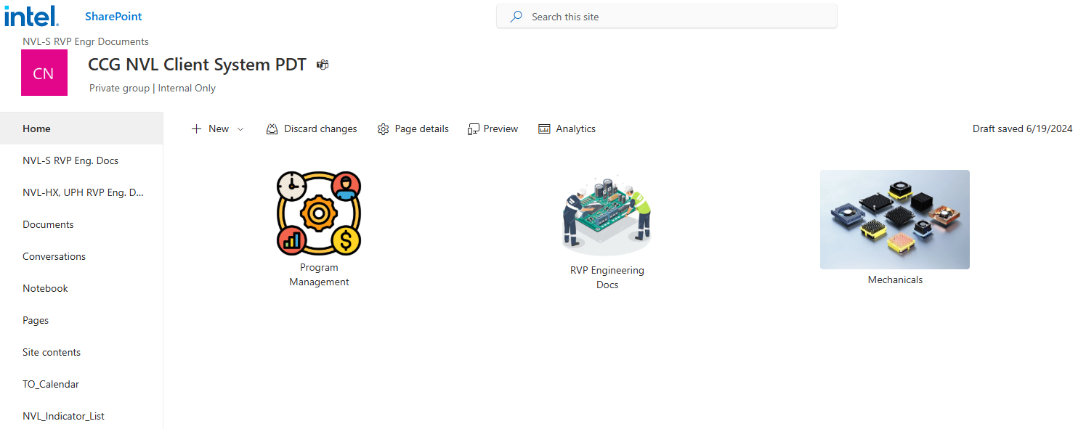
NVL PDT SharePoint
Link: NVL-S RVP Collaterals

Slide 10
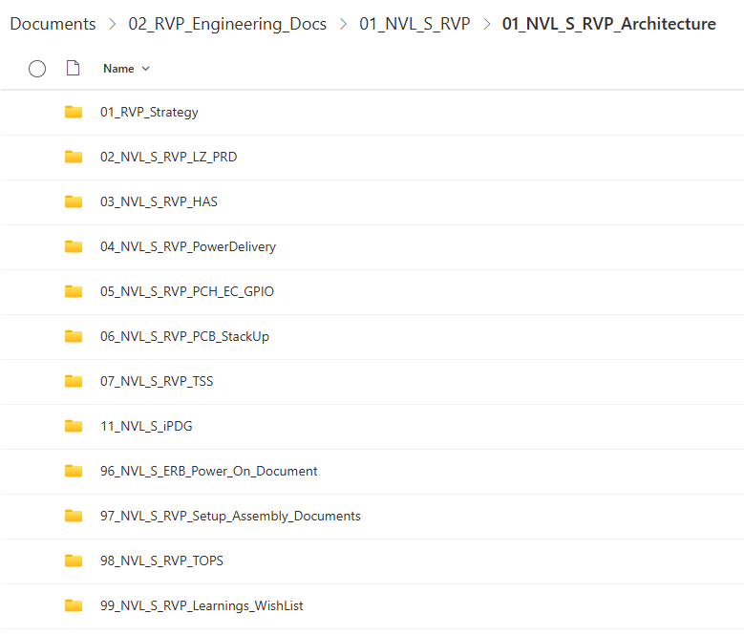
NVL-S RVP Architecture Document
Important documents for validation teams
RVP Landing Zone
RVP HAS / system block-diagram
RVP PD design / PnP validation
Platform GPIO mapping table (BIOS / EC / IFWI)
RVP assembly guides
TOPS, this document
Link:
NVL-S RVP Architecture Documents

Slide 11
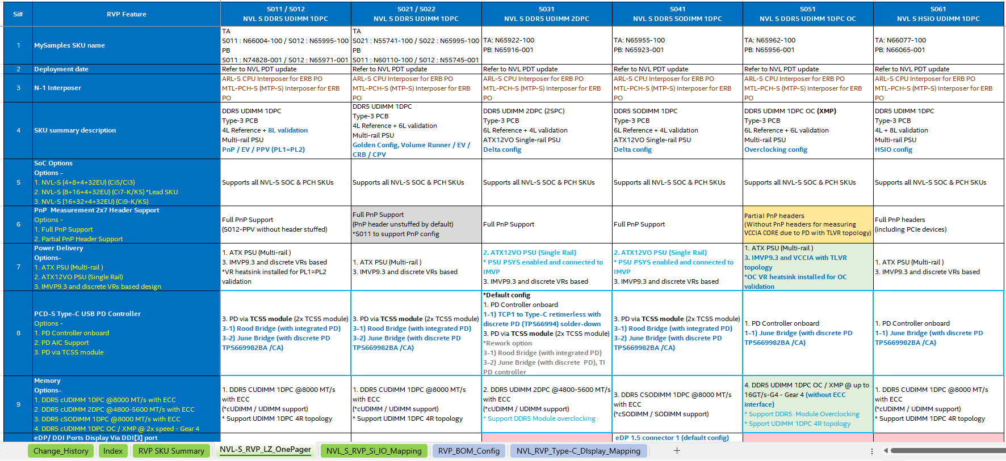
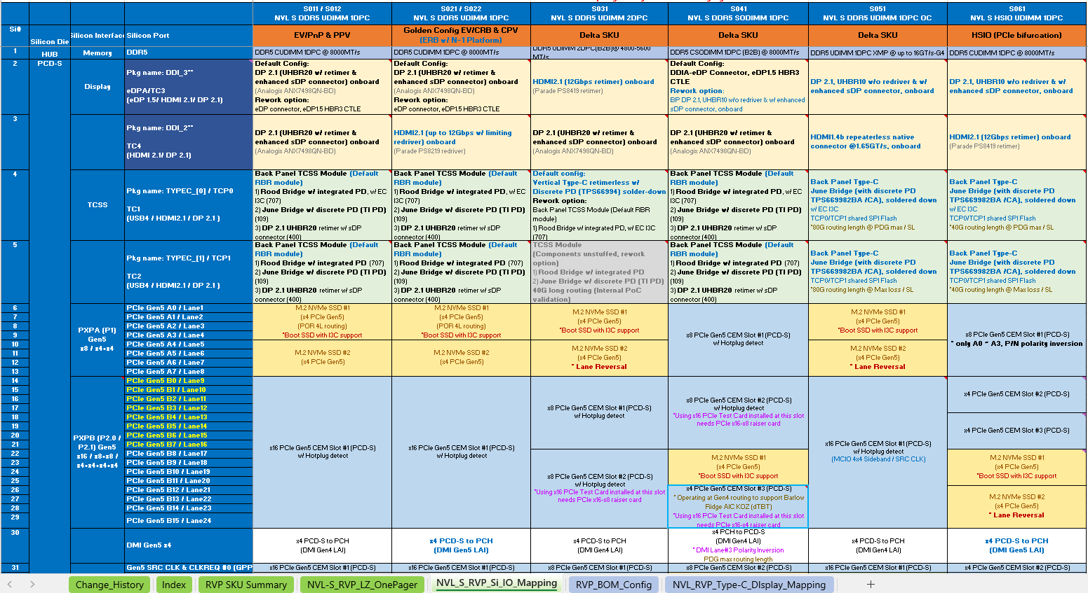
NVL-S RVP Landing Zone
NVL_S_RVP_Si_IO_Mapping
NVL-S_RVP_LZ_OnePager
Source link: NVL-S RVP LZ

Slide 12
RVP Boot Kit and AICs
Home

Slide 13
Boot Kit for NVL-S RVP
Sr. NO. 4b is for S-041 only, 4a is for rest of SKUs
Sr. No. | Item Type | IPN |  | Item Description | Qty
1 | CPU Heat sink(65W) | M67546-001 |  | FOXCONN 1A21D7Q00-DRB | 1
2 | NVP-S ISC Socket | N69163-001 |  | NVP-S PCH ISC Socket | 1
3 | NVP-S Hardware Assembly kits | N77767-001 |  | NVP-S Hardware Assembly kits | 1
4a | DDR5 cUDIMM Module* | 1st source | N51192-001 | HMCG78AHBCA311N 16GB 6400MHz | either 1 source*2
 |  | 2nd source | N78730-001 | HMCG78AHBCA313N 16GB 6400MHz
4b | DDR5 cSODIMM Module* | 1st source | N80564-001 | HMCG78CKBVA312N 16G 7200MHz | either 1 source*2
 |  | 2nd source | N80563-001 | HMCG78CKBVA315N 16G 7200MHz
*Will transit to DDR5 8000 Modules once available.

Slide 14
AICs Supported for NVL-S RVP
Item | Detailed Information |  | New or Reused
 | AA IPN | Description
1 | M74200-200 | ARL-S LPSS AIC | Reuse from ARL-S
2 | M74186-200 | FP PCH USB3.2 PDLESS Type-C AIC (PS8825) | Reuse from ARL-S
3 | N60014-101 | DT TomCAT PD AIC (TPS66994) | New, paired with BR AIC 2.0
4 | N77063-100 | Brown Bear AIC 2.0 | Reuse from ARL-S with BOM update
5 | N77706-100 | TCSS 109 JBR Single DT | New
6 | N77141-100 | TCSS 707 RBR Single DT | New
7 | N77704-100 | TCSS 400 DP2.1 retimer | Reused from ECG
8 | N42428-100 | TCSS 302 HDMI 2.1 retimer | Reused from PTL

Slide 15
Board Placement Review
Home

Slide 16
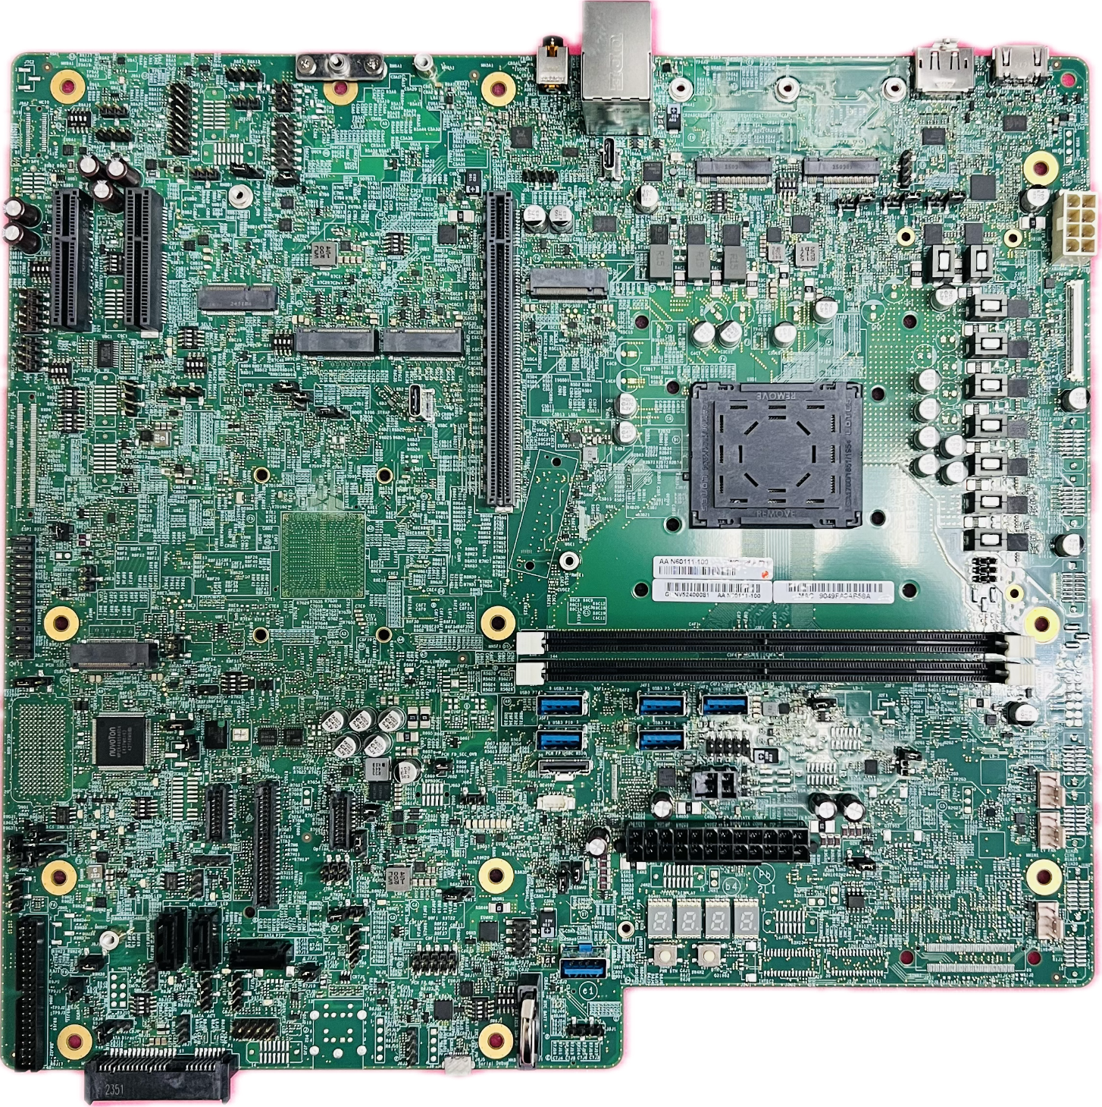
NVL-S RVP Key IO Area
Audio Jack / BP USB Ports / RJ45
TCSS Ports or M.2 AIC
Display IO Area
PSU Connector
PCIe CEM Slot
M.2 SSD
M.2 WLAN
LPSS AIC HDR
CPU
PCH
eSPI HDR
DDR5 slots
SPI devices
MECC HDR
FP USB Connectors
PSU Connector
FAN Connectors
PM Sideband HDR
SATA Connectors
InTEC/Sinai
Micro AB USB Connector

Slide 17
RJ45/ USB3.2 Type-A x2
S01x/S02x 1DPC RVP Top View
3.5mm AUDIO JACK
TCP0 Modular IO
(80G)
TCP1 Modular IO
(80G)
DP UHBR20 CONN in S01x SKUs
DP UHBR20 (DDI3)
HDMI 12G (DDI2)
U3 P3 U2 P10 U3 P4 U2 P8
SSD Bracket for PCH SSD#5
PXPA[0:1]
PXPD[0:3]
U3 P1/P2 U2 P9
PD-less Type-C USB3.2 Gen2x2
PSU
CPU
12V
X4 PCH PCIe Slot#2
PXPA3
X2 PCH PCIe Slot#3
PCD M.2 SSD#1
WLAN M.2 Slot
PXPF[0:3]
PCD A[4:7]
X16 PEG Slot
eDP (DDI3)
PCH M.2 SSD#5
PCD M.2 SSD#2
PCD A[0:3]
Rework option
LPSS HDR
LGA1954 Socket
NVP-S PCH
PCD B[0:15]
eSPI HDR
PXPE[0:3]
PCH M.2 SSD#3
DDR5 UDDIMM (Ch0/2) ; SPD address=A0
DDR5 UDDIMM (Ch1/3) ; SPD address=A4
U3 P9 U2 P5
Vertical USB-A
Vertical USB-A
Vertical USB-A
U3 P5 U2 P13
U2 P3
U3 P10 U2 P12
Vertical USB-A
Vertical USB-A
MECC Conn
U3 P6 U2P14
U3 P7/P8 U2 P11
FP PD-less AIC PWR CONN
CPU FAN HDR
SF600/TPM
FP PD-less AIC USB3.2 Gen2x2 HSIO CONN
TTK3 HDR
2x12 ATX PSU HDR
EV FAN HDR(Always ON)
SATA Cable
FP PD-less AIC Sideband CONN
PORT 80 LED
Chassis FAN HDR
SATA Cable
SATA Cable
U2 P1
PM Sideband header
PWR BTN
RST BTN
RTC Battery
InTEC (PCH)
InTEC (CPU)
Sinai
Vertical USB2.0 for PPV and DCI Debug via Type-A
PS/2 CONN
Micro AB USB(Serial debug)
SATA Direct Conn

Slide 18
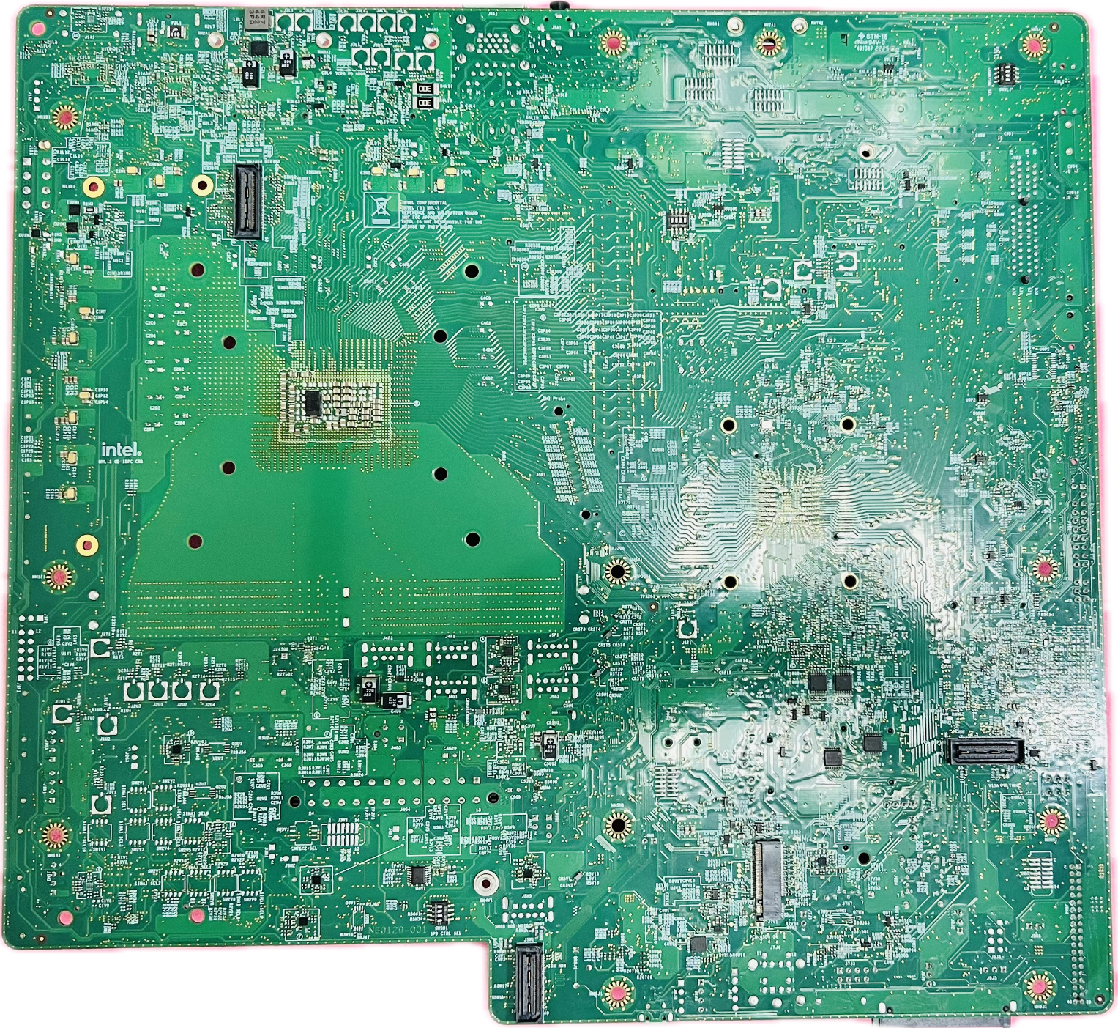
S01x/S02x 1DPC RVP Bottom View
Merged MIPI60
PCH VISA HDR
PCH M.2 SSD#4
ISH HDR

Slide 19
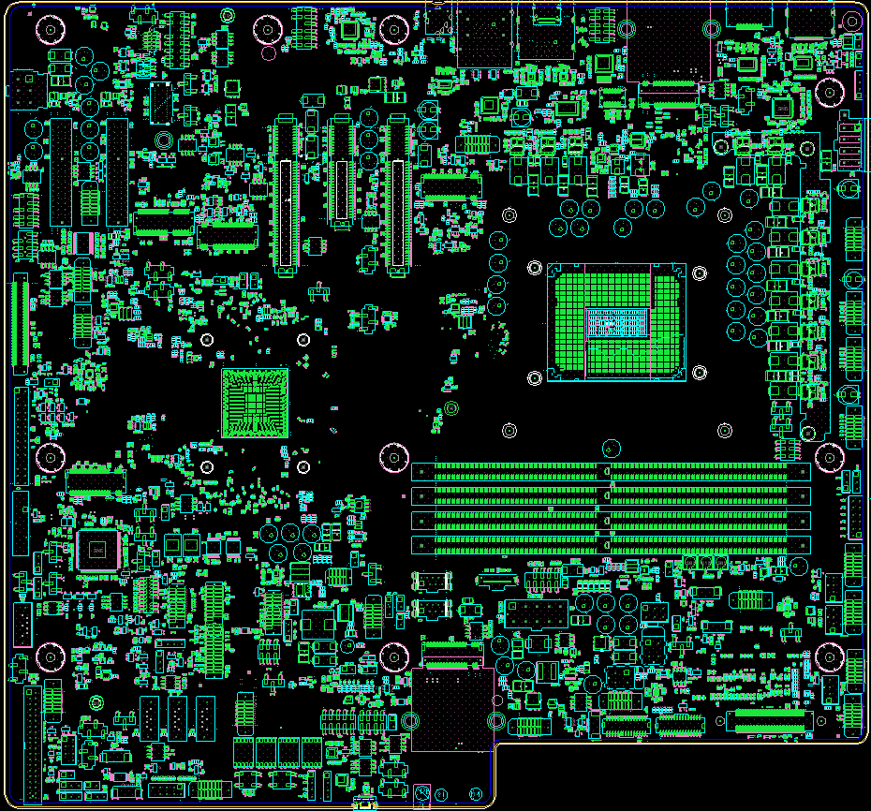
3.5mm AUDIO JACK
RJ45 /
USB3.2 (P3)/
USB3.2 (P4)
S031 2DPC RVP Top View
USB3.2 (P5)/
USB3.2 (P6)/
PD-less Type-C
USB3.2X2 (P1&P2)
TCP0 retimer-less
USB3.2 + DP1.4
HDMI 12G
(DDI3)
FSDP UHBR20 (DDI2)
TCP0 TCSS M.2(80G)
PCIe 12V
PWR CONN
Rework option
PSU CPU 12V
PCH X2 SLOT (PXPB0~1)
PCD X8 SLOT (PXPB0~7)
PCH X2 SLOT (PXPA0~3)
PCD X8 SLOT (PXPB8~15)
PCD M.2 SSD
(PXPA0~3)
PCH X4 SLOT
(PXPF0~3)
WLAN M.2 Slot
PCD M.2 SSD
(PXPA4~7)
LPSS AIC HDR
NVP-S PCH
LGA1954 Socket
eSPI debug HDR
PCH M.2 SSD
(PXPE0~3)
DDR5 UDIMM (Ch0/2) ; SPD add=A0
DDR5 UDIMM (Ch0/2) ; SPD add=A2
CPU Fuse Programming HDR
RTC Battery
DDR5 UDIMM (Ch1/3) ; SPD add=A4
DDR5 UDIMM (Ch1/3) ; SPD add=A6
Vertical USB-A (P9)
USB2 FP HDR
CPU FAN HDR
SATA(P4) Cable
SF600 HDR
TPM HDR
Vertical USB-A (P10)
2x5 ATX 12V HDR
2X3 SATA PWR CONN
EV FAN HDR(Always ON)
TTK3 HDR
FP PD-less
AIC SB HDR
Chassis FAN HDR
PM Sideband HDR
SINAI2/NEVO Conn
SATA(P7) Cable
PORT 80 LED
Brown Bear AIC PWR CONN
SATA(P6) Cable
InteC (PCH)
InteC (CPU)
FP PD-less AIC PWR CONN
PWR BTN
SATA(P5) Cable
RST BTN
FP PD-less type-C
USB3.2 X2 (P7&P8)
PCH FAN HDR
Micro AB USB(Serial debug)

Slide 20
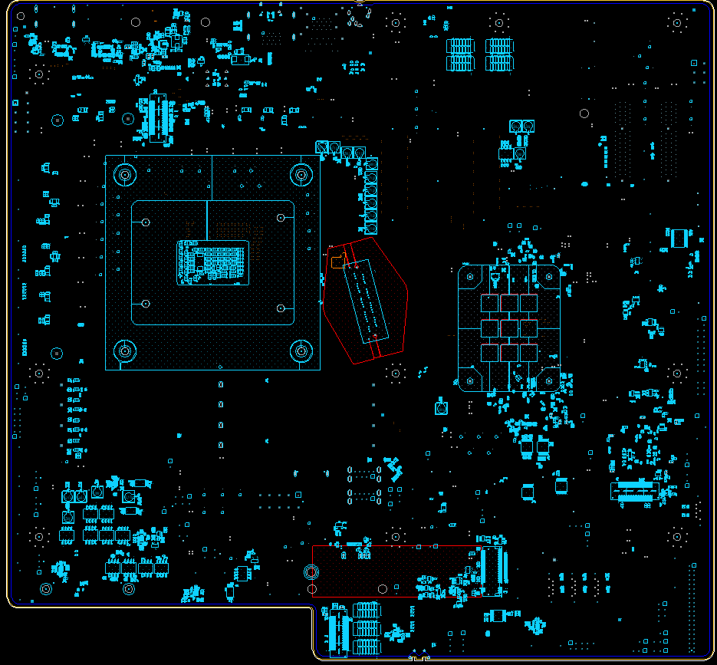
S031 2DPC RVP Bottom View
Merged MIPI60
Merged MIPI60
PCH VISA HDR
PCH M.2 SSD
(PXPD0~3)
PCH VISA HDR
PCH M.2 SSD-2
Mosaic AIC
ISH HDR

Slide 21
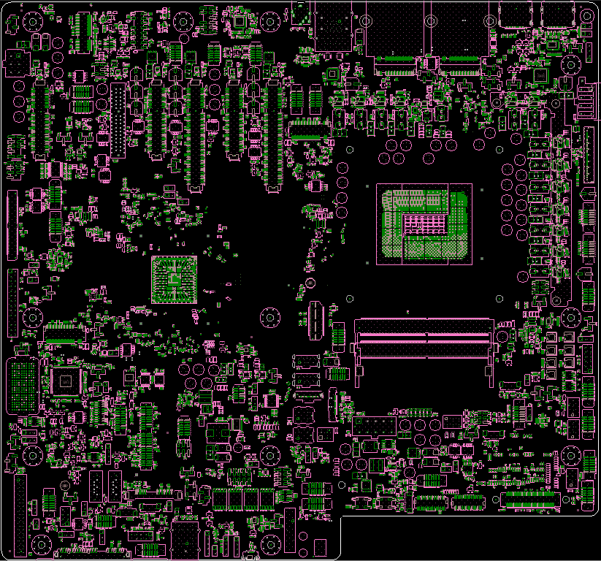
S041 SODIMM RVP Top View
Rework option
3.5mm
Audio
Jack
RJ45
USB3 P3
USB3 P4
TCP0
M.2 TCSS
Module
TCP1
M.2 TCSS
Module
DDI3
FsDP UHBR10
DDI2
FsDP UHBR20
M.2
WiFi/BT
M.2
WiFi/BT
JA
JS
PCIe 2x3
12V HDR
JH
PSU CPU 12V
2x4 HDR
PCD x4 PEG CEM #3
PCH x4 CEM #3
PXPB B12~B15
PXPE E0~E3
PCH x4 CEM #2
SSD #1
PXPC C0~C1
PCD x8 PEG CEM #2
PCD x8 PEG CEM #1
PXPF F0~F3
PCH x4 CEM #1
PXPB B0~B7
PXPA A0~A7
JE
B8~B11
DDIA
eDP 60-pin connector
JD
LPSS HDR
NVP-S
PCH
LGA1954 Socket V2
eSPI HDR
SSD #3
FuSa
60 pin
DDR5 SODIMM (Ch0/2) ; SPD addr=A0
PXPD x4
DDR5 SODIMM (Ch1/3) ; SPD addr=A4
CPU Fuse Programming
HDR
EC
USB3 P9
MECC
Connector
USB3 P10
FP USBC
P1 / P2
THC Panel
20-pin HDR
CPU Fan HDR
SF600
TPM
PCH USBC +5V
2x5 ATX
12V HDR
SATA
Power
EV Fan HDR
TTK3 HDR
BR AIC
+5V
VBY1
PWR
PCH USBC
SB HDR
Chassis Fan HDR
SATA #1
SATA #2
SATA #3
Port 80 Display
ZPODD
VBY1
PM Sideband
PCH Fan HDR
PWR
BTN
RST
BTN
InTEC
(CPU)
RTC
Coin Cell
InTEC
(PCH)
SINAI2/NEVO
ECG features
SATA #0 Direct
uAB USB
(Serial Debug)

Slide 22
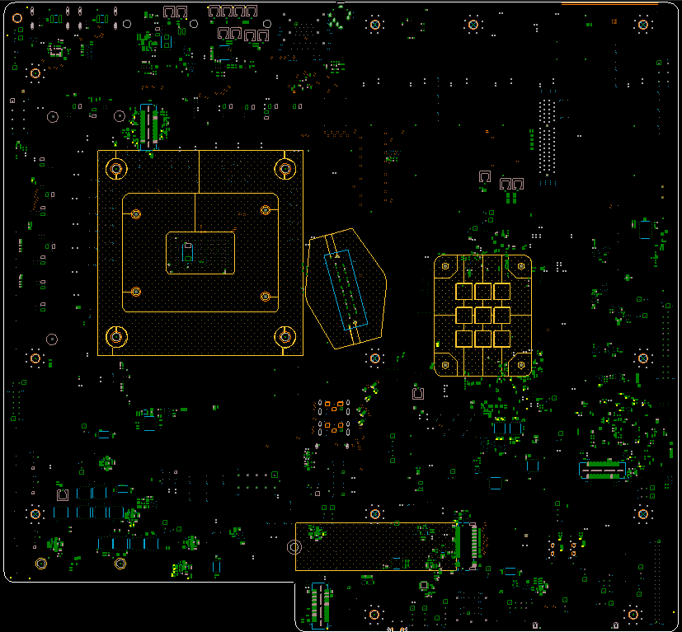
S041 SODIMM RVP Bottom View
Merged MIPI60
DMI Probe
PCH MIPI 60
SSD #4
ISH MASOIC HDR

Slide 23
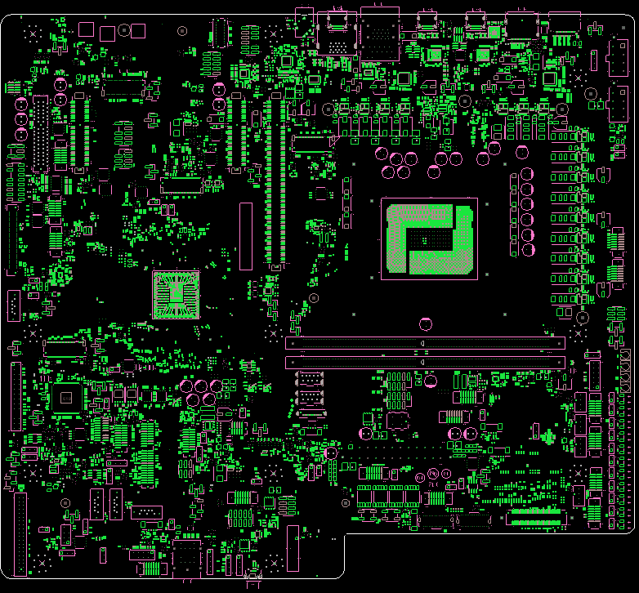
S051 OC RVP Top View
3.5mm AUDIO JACK
USB3.2 (P5)/
USB3.2 (P6)/
PD-less Type-C
USB3.2X2 (P1&P2)
RJ45 /
USB3.2 (P3)/
USB3.2 (P4)
FSDP UHBR10 (DDI3)
HDMI 1.65G
(DDI2)
JBR TCP0
JBR TCP1
PSU CPU 12V
WLAN M.2 Slot
PSU CPU 12V
PCH X4 SLOT
(PXPE0~3)
PCH X4 SLOT
(PXPA0~3)
PCH X4 SLOT
(PXPF0~3)
PCD M.2 SSD
(PXPA0~3)
PCD X8 SLOT (PXPB0~15)
PCD M.2 SSD
(PXPA4~7)
LPSS AIC HDR
SATA(P0) Cable
NVP-S PCH
LGA1954 Socket
PCH M.2 SSD
(PXPD0~3)
DDR5 UDIMM (Ch0/2) ; SPD add=A0
DDR5 UDIMM (Ch1/3) ; SPD add=A4
CPU Fuse Programming HDR
Vertical USB-A (P9)
USB2 FP HDR
eSPI debug HDR
Vertical USB-A (P10)
USB2 FP HDR
2nd Chassis FAN HDR
FP PD-less type-C
USB3.2 X2 (P7&P8)
FP PD-less AIC PWR CONN
SF600 HDR
TPM HDR
PCH FAN HDR
CPU FAN HDR
TTK3 HDR
2x12 ATX Conn
EV FAN HDR(Always ON)
SATA(P2) Cable
FP PD-less
AIC SB HDR
PORT 80 LED
Chassis FAN HDR
PM Sideband HDR
SATA(P1) Cable
SATA(P3) Cable
PWR BTN
RST BTN
InteC (PCH)
InteC (CPU)
SINAI2/NEVO Conn
RTC Battery
Micro AB USB (Serial debug)

Slide 24
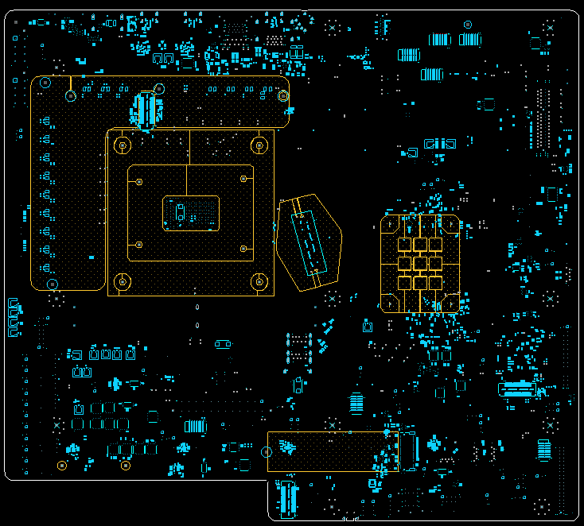
S051 OC RVP Bottom View
Merged MIPI60
PCH M.2 SSD
(PXPC0~3)
PCH VISA HDR
Mosaic AIC

Slide 25
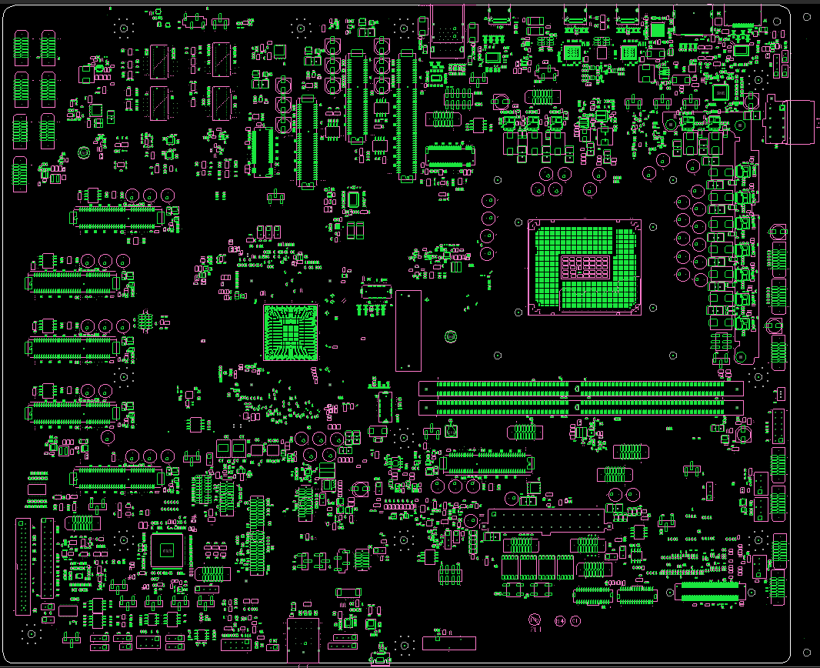
S061 HSIO RVP Top View
BP type-A
USB3.2 P5/6
USB2.0 P13/14
USB2.0 3/4
FSDP UHBR10 (DDI3)
PD-less TypeC USB3.2 (P1/2)
USB2 (P9)
JBR TCP0
JBR TCP1
HDMI 12G
(DDI2)
MCIO2
MCIO3
PCD X4 PCIe CEM #2
(PXPB0~3)
PD Controller Header
MCIO1
MCIO4
PCD X8 PCIe CEM #1 (PXPA0~7)
PSU CPU 12V
PCD X4 PCIe CEM #3
(PXPB4~7)
PCD M.2 SSD#2
(PXPB12~15)
PCD M.2 SSD #1
(PXPB8~11)
PCH X4 PCIe CEM #5
(PXPE0~3)
PCH X4 PCIe CEM #4
(PXPD0~3)
FP type-C internal Cable
USB3.2 P7&P8
USB2.0 P11
PCH X4 PCIe CEM #1
(PXPA0~3)
NVP-S PCH
LGA1954 Socket
FP Type-A Internal Cable
USB3.2 P9/10
USB2.0 P5/12
DDR5 UDIMM (Ch0/2) ; SPD add=A0
PCH X4 PCIe CEM #2
(PXPB0~3)
DDR5 UDIMM (Ch1/3) ; SPD add=A4
PCH X4 PCIe CEM #6
(PXPF0~3)
PCH X4 PCIe CEM #3
(PXPC0~3)
CPU FAN HDR
SF600 HDR
EV FAN HDR(Always ON)
PM Sideband HDR
TTK3 HDR
2x12 ATX Conn
PORT 80 LED
Chassis FAN HDR
PCH FAN HDR
PWR BTN
eSPI debug HDR
RST BTN
InteC (PCH)
InteC (CPU)
SINAI2/NEVO Conn
RTC Battery
uAB Serial debug

Slide 26
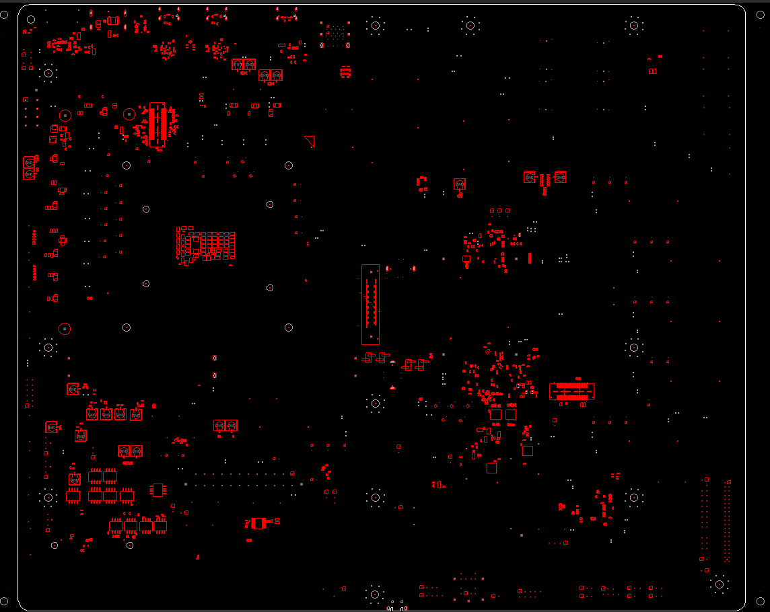
S061 HSIO RVP Bottom View
Merged MIPI60
DMI Midbus Probe
PCH VISA HDR

Slide 27
High-Level RVP Overview
Home

Slide 28
NVL-S RVP Block Diagram
S011/S012 UDIMM 1DPC
Reference link: NVL-S RVP LZ

Slide 29
NVL-S RVP Block Diagram
S021/S022 UDIMM 1DPC
Reference link: NVL-S RVP LZ

Slide 30
NVL-S RVP Block Diagram
S031 UDIMM 2DPC
Type-C Retimerless
Reference link: NVL-S RVP LZ

Slide 31
NVL-S RVP Block Diagram
S041 SODIMM 1DPC
Reference link: NVL-S RVP LZ

Slide 32
NVL-S RVP Block Diagram
S051 UDIMM 1DPC OC
Reference link: NVL-S RVP LZ

Slide 33
NVL-S RVP Block Diagram
S061 HSIO
Reference link: NVL-S RVP LZ

Slide 34
Memory
Home

Slide 35
NVL-S RVP UDIMM Memory Specification
S011/S012/S021/S022/S061 Memory Details
Type | DDR5 cUDIMM 1DPC (T3 4L POR)
Topology | Interleaved routing
Size | Boot kit support 16GB (1R x8) Max System Capacity 128GB
Placement | UDIMM slot x2
POR SPEED | 8000 MT/s
MPN | Refer to Boot-kit page
S031 Memory Details
Type | DDR5 cUDIMM 2DPC (T3 6L POR)
Topology | Interleaved routing
Size | Boot kit support 16GB (1R x8) Max System Capacity 256GB
Placement | UDIMM slot x4
POR SPEED | 0r2r-5600 2r2r-5200
MPN | Refer to Boot-kit page
S051 Memory Details
Type | DDR5 UDIMM 1DPC XMP (T3 6L POR)
Topology | Interleaved routing
Size | Boot kit support 16GB (1R x8) Max System Capacity 128GB
Placement | UDIMM slot x2
POR SPEED | Up to 16GT/s – Gear 4
MPN | Refer to Boot-kit page

Slide 36
DDR5 UDIMM 1DPC B2B Memory Topology
DDR5 routing on NVL-S 1DPC will be point-to-point routing for all the DDR5 signals. DDR5 UDIMMs will be placed back-to-back as shown in the figure given below for NVL-S011 / S012 / S021 / S022 / S061 RVP.
With ECC signals
With 4R cUDIMM (PoC)

Slide 37
DDR5 UDIMM 2DPC B2B Memory Topology
DDR5 routing on NVL-S 2DPC will be daisy chain for CA/DQS/DQ/ECC and point-to-point routing for CLK/CS signals. DDR5 UDIMMs will be placed back-to-back as shown in the figure given below for NVL-S S031
ECC Supported

Slide 38
DDR5 UDIMM 1DPC OC B2B Memory Topology
DDR5 routing on NVL-S 1DPC will be point-to-point routing for all the DDR5 signals. DDR5 UDIMMs will be placed back-to-back as shown in the figure given below for NVL-S S051.
Without ECC signals
With 4R cUDIMM

Slide 39
NVL-S RVP SODIMM Memory specification
S041 Memory Details
Type | DDR5 cSODIMM 1DPC (T3 6L POR)
Topology | Interleaved routing
Size | Boot kit support 16GB (1R x8) Max System Capacity 128GB
Placement | SODIMM slot x2
POR SPEED | 8000 MT/s
MPN | Refer to Book-kit page

Slide 40
DDR5 SODIMM 1DPC B2B Memory topology
DDR5 routing on NVL-S 1DPC will be point-to-point routing for all the DDR5 signals. DDR5 SODIMMs will be placed back-to-back as shown in the figure given below for NVL-S041 SODIMM 1DPC RVP.
ECC Supported.

Slide 41
TCSS/DDI
Home

Slide 42
TCSS/DDI Mapping
 |  | S-01x LGA-UDIMM-1DPC | S-02x LGA-UDIMM-1DPC | S-031 LGA-UDIMM-2DPC | S-041 LGA-SODIMM-1DPC | S-051 LGA-UDIMM-1DPC-OC | S-061 LGA-UDIMM-1DPC-HSIO
NVL-S CPU | DDI3 | DP2.1 UHBR20 Retimer with Full-sized DP CONN (Rework Option : eDP1.5 HBR3 CTLE with eDP CONN) | DP2.1 UHBR20 Retimer with Full-sized DP CONN (Rework Option : eDP1.5 HBR3 CTLE with eDP CONN) | HDMI2.1 12Gbps Retimer with HDMI CONN | eDP1.5 HBR3 CTLE with eDP CONN (Rework Option : DP2.1 UHBR10 Main Link with Full-sized DP CONN) | DP2.1 UHBR10 Main Link with Full-sized DP CONN | DP2.1 UHBR10 Main Link with Full-sized DP CONN
 | DDI2 | DP2.1 UHBR20 Retimer with Full-sized DP CONN | HDMI2.1 12Gbps Limiting Redriver with HDMI CONN | DP2.1 UHBR20 Retimer with Full-sized DP CONN | DP2.1 UHBR20 Retimer with Full-sized DP CONN | HDMI1.4b Cost-Reduction 1.65Gbps with HDMI CONN | HDMI2.1 12Gbps Retimer with HDMI CONN
 | TCP0 | Back Panel TCSS Modular IO M.2 CONN | Back Panel TCSS Modular IO M.2 CONN | Vertical Type-C Retimerless with Onboard PD Controller TI TPS66994 Rework Option : Back Panel TCSS Modular IO M.2 CONN | Back Panel TCSS Modular IO M.2 CONN | Back Panel TCP JBR 80Gbps with Onboard PD Controller TI TPS669982 | Back Panel TCP JBR 40Gbps with Onboard PD Controller TI TPS669982
 | TCP1 | Back Panel TCSS Modular IO M.2 CONN | Back Panel TCSS Modular IO M.2 CONN | (Removed from the validation plan) | Back Panel TCSS Modular IO M.2 CONN | Back Panel TCP JBR 80Gbps with Onboard PD Controller TI PTPS669982 | Back Panel TCP JBR 40Gbps with Onboard PD Controller TI PTPS669982
dTBT | Barlow Ridge on Brown Bear AIC | N/A | N/A | 1x dTBT Barlow Ridge AIC @ PCH PCIe x4 CEM slot #2 | 1x dTBT Barlow Ridge AIC @ PCD-S PCIe x4 CEM slot #3 | N/A | N/A

Slide 43
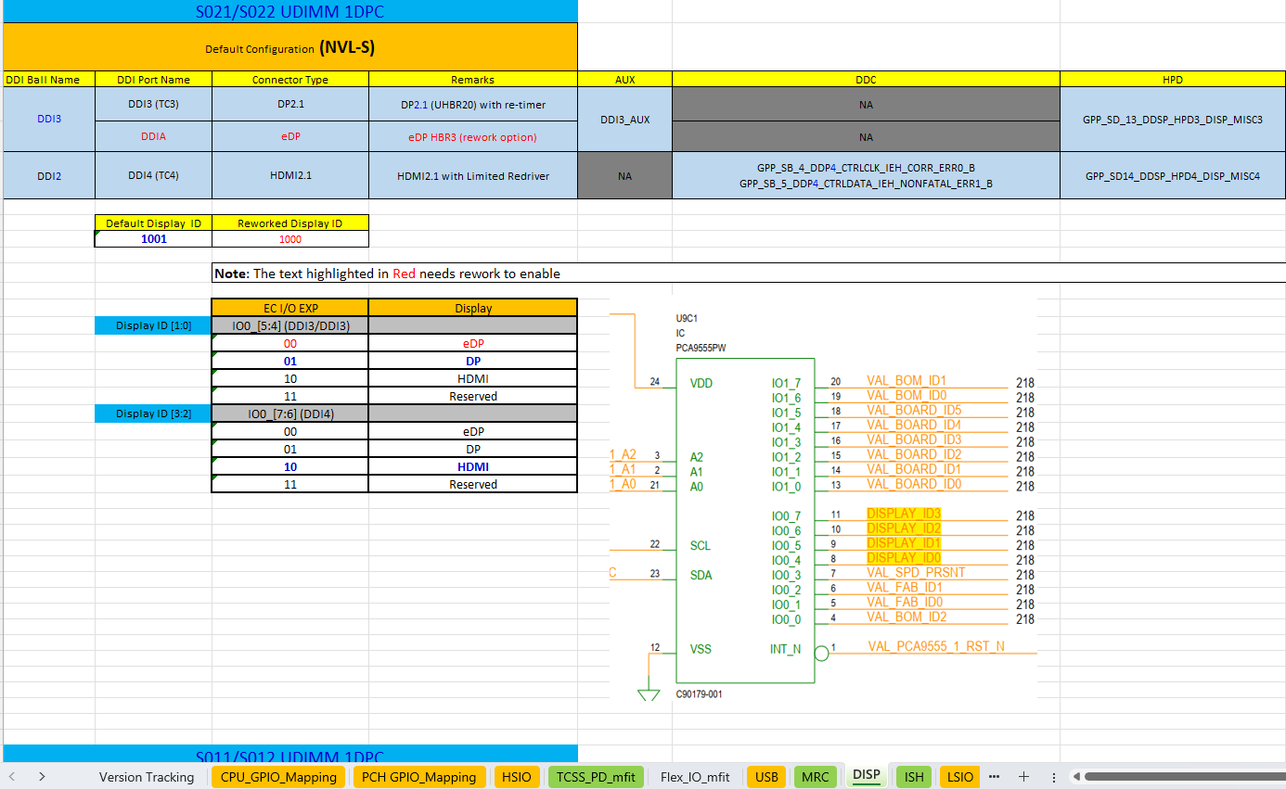
Display GPIOs
02_Platform Mapping
The Display GPIOs will be mentioned in detail at Platform Mapping Document
DISP sheet in S02x Platform GPIO Mapping Document

Slide 44
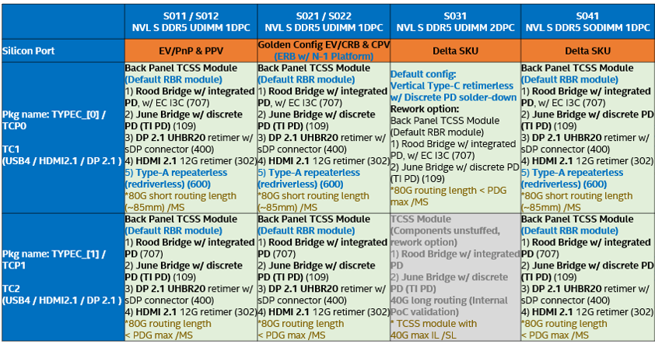
TCSS Modular IO Diagram
Following TCSS AICs are supported via TCSS M.2 Slots
TCSS 109 JBR
TCSS 301/302 HDMI
TCSS 400 DP2.1
TCSS 600 type-A re-driverless
Not all type of AICs can be supported because routing length request difference on RVP SKUs ,
Please refer to row 3,4 of “NVL_RVP_Type-C_DIsplay_Mapping” of NVL-S RVP LZ for detail

Slide 45
JBR Soldered Down Diagram
Port Configuration
2 TCP Ports with on board JBR + PD on NVL-S051 OC / NVL-S061 HSIO RVP
PD Controller :
TI TPS669982 PD Controller (CFP2.0)
5V, 3A per port
2x5 header used for FW update and debug
EC I2C used for capsule FW update
Re-timer:
June Bridge
2x3 header used for FW update by SF600
LSx are used for capsule FW update

Slide 46
Index of RBR/JBR Retimer, Barlow Ridge, PD Controller FW Programing Guide
Refer to TCSS/DDI Mapping to see the TCSS configuration of each sku and find applicable flash guide below.
RBR/JBR Retimer Programming Guide : link
Barlow Ridge TBT Controller Programming Guide : link
PD Controller Programming Guide : link

Slide 47
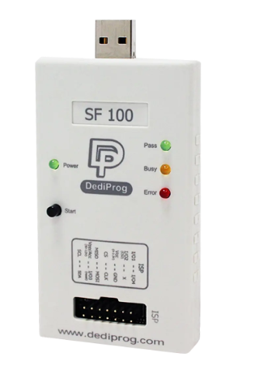
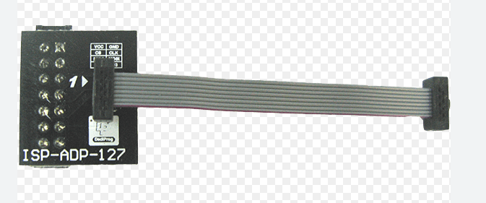
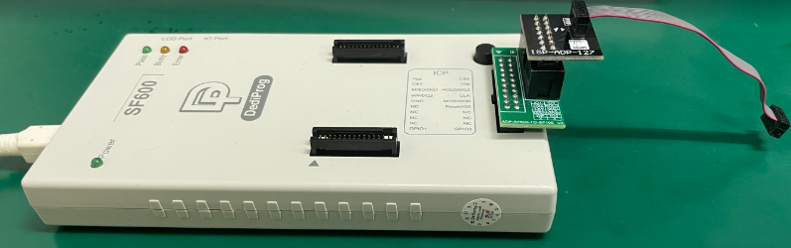
RBR/JBR Retimer Flash Programing
2x3 header (1.27mm pitch) on TCSS module or RVP is provided to program JBR retimer flash.
See next 3 pages for the HDR location.
Can use SF100+ISP-ADP-127 or SF600 + ADP-SF600-TO-SF100 + ISP-ADP-127. See below pictures.
The cable has 2x4 header and the last two pins are NOT connected TCSS module or RVP header.
Keep the flash programmed only in RVP powered OFF state (G3 state) and Dediprog will be Master providing 1.8V power supply for the JBR flash
TCSS module 2X3 Header Pin Out
2 | 4 | 6
GND | CLK | MOSI
1 | 3 | 5
VCC | CS | MSIO
SF100
ISP-ADP-127
Or
ISP-ADP-127 2X4 Header Pin Out
2 | 4 | 6 | 8
GND | CLK | MOSI | I/O3
1 | 3 | 5 | 7
VCC | CS | MSIO | Vpp/Acc
No connected
SF600
ADP-SF600-TO-SF100
ISP-ADP-127

Slide 48
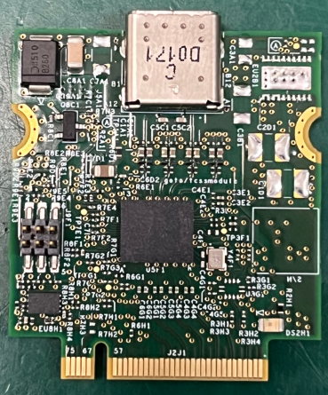
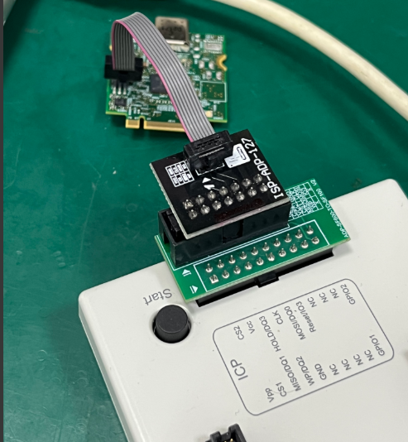
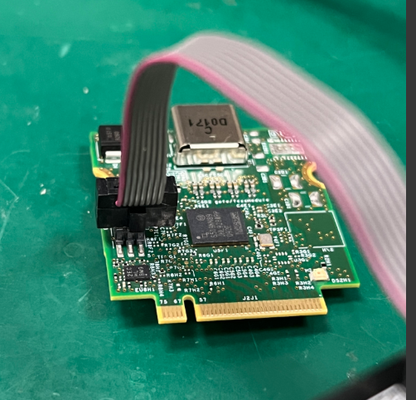
TCSS 707 RBR Flash Programming Header
J9F1 2X3 Header Pin Out
2 | 4 | 6
GND | CLK | MOSI
1 | 3 | 5
VCC | CS | MSIO
Connection be like:
2 4 6
J9F1
1 3 5
pin1
pin1

Slide 49
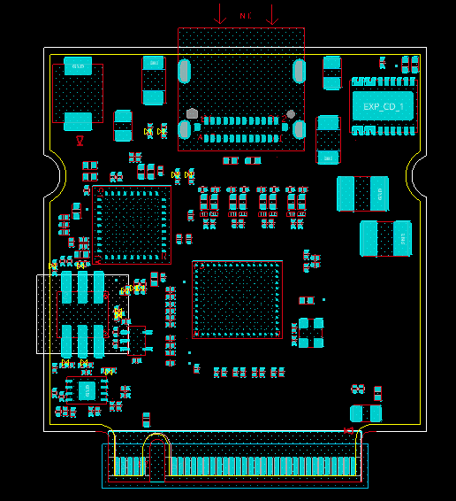
TCSS 109 JBR Flash Programming Header
2 4 6
J9F1 2X3 Header Pin Out
2 | 4 | 6
GND | CLK | MOSI
1 | 3 | 5
VCC | CS | MSIO
J9F1
1 3 5

Slide 50
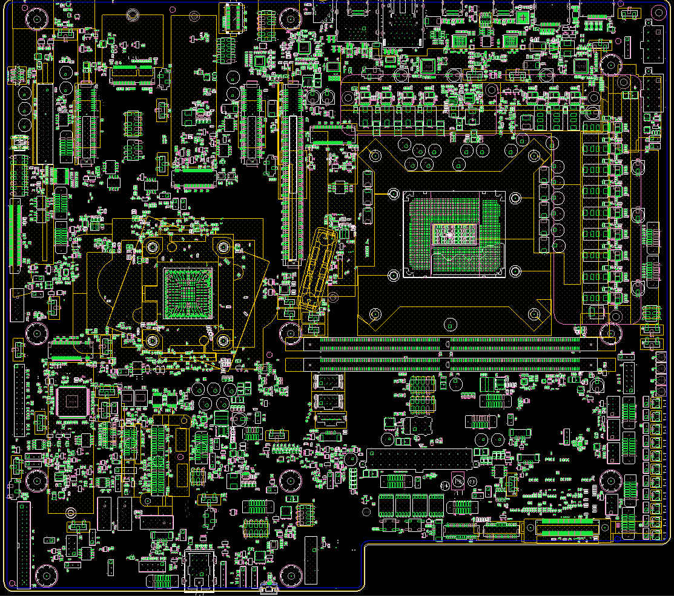
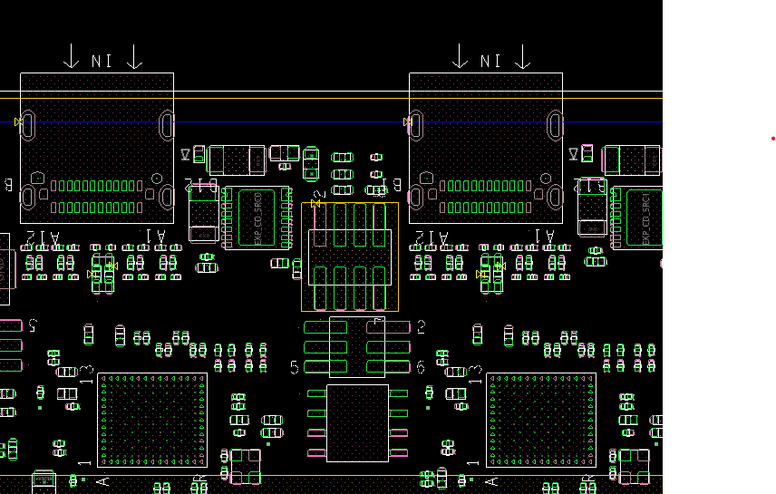
S-051 JBR Flash Programming Header
J12101
1
3
5
2
4
6
J12101 2X3 Header Pin Out
2 | 4 | 6
GND | CLK | MOSI
1 | 3 | 5
VCC | CS | MSIO

Slide 51
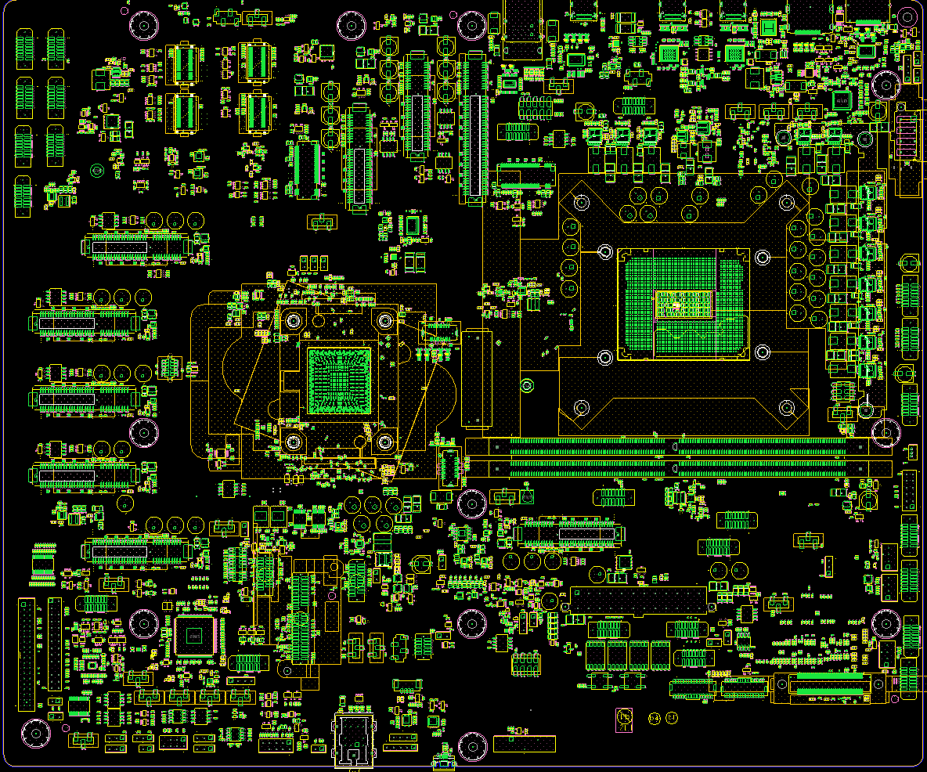
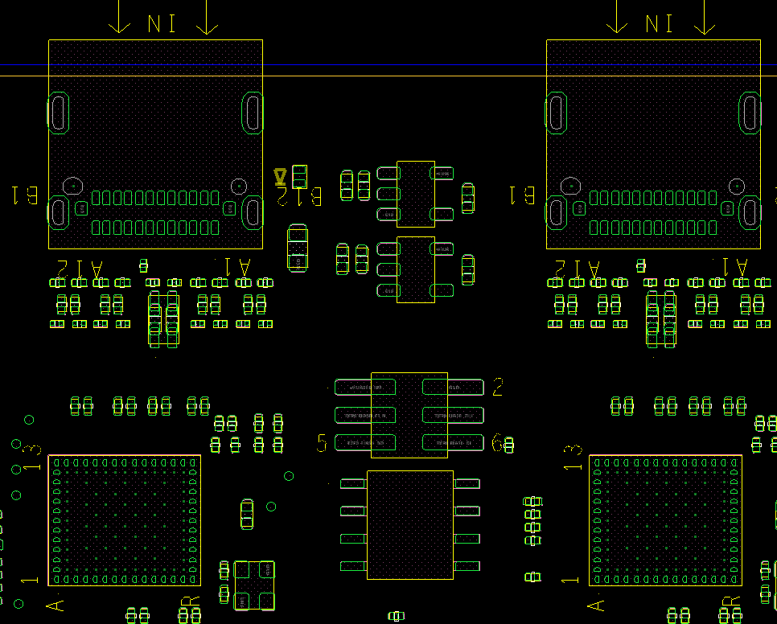
S-061 JBR Flash Programming Header
J12101
1
3
5
2
4
6
J12101 2X3 Header Pin Out
2 | 4 | 6
GND | CLK | MOSI
1 | 3 | 5
VCC | CS | MSIO

Slide 52
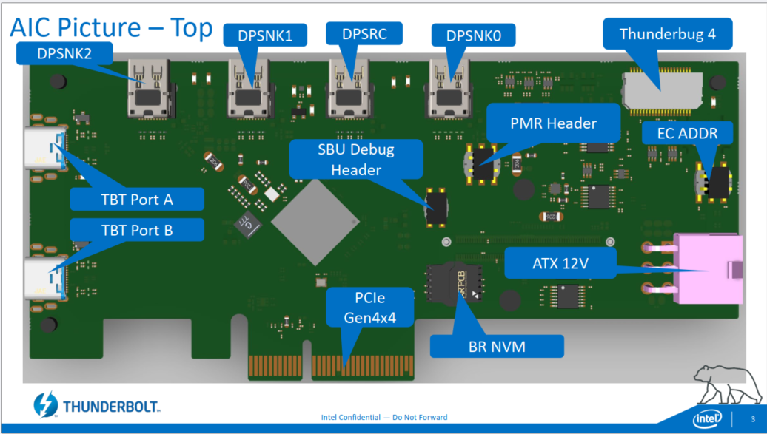
Brown Bear Flash Programming
Brown Bear AIC offers a flash socket on AIC, and flash ROM is installed in it. See below picture.
Please remove it from socket and flash it by dediprog and applicable flash socket. The flash size is SOIC-8 150-mil
Remove flash from socket

Slide 53

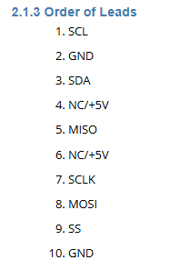
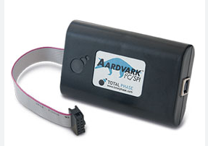
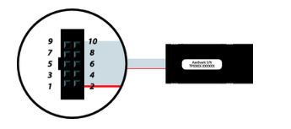
PD Controller FW Programming
See the table for PD configuration on each sku.
We use RVP power to program PD FW, so please insert TCSS modules or Brown Bear AIC + PD AIC into RVP for FW programming
EC-PD I2C is available on HDR on RVPAIC. Please check the pinout in following pages and connect I2C_SCL, I2C_SDA, GND to Aardvark
This PD controller FW could be programmed by using Aardvark I2C host, please refer to BKM below for detail steps.
Programming guidelines for TI66994 & TI669982: BKM_Tomcat_PD_FW_Update.pdf
SKU | S011 UDIMM 1DPC | S021 UDIMM 1DPC | S031 UDIMM 2DPC | S041 SODIMM 1DPC | S051 OC | S061 HSIO | Brown Bear
PD Controller | Sky Warrior PD on TCSS module | Sky Warrior PD on TCSS module | Tomcat PD on RVP | Sky Warrior PD on TCSS module | Sky Warrior PD on RVP | Sky Warrior PD on RVP | Tomcat on PD AIC
HDR location | link | link | link | link | link | link | link

Slide 54
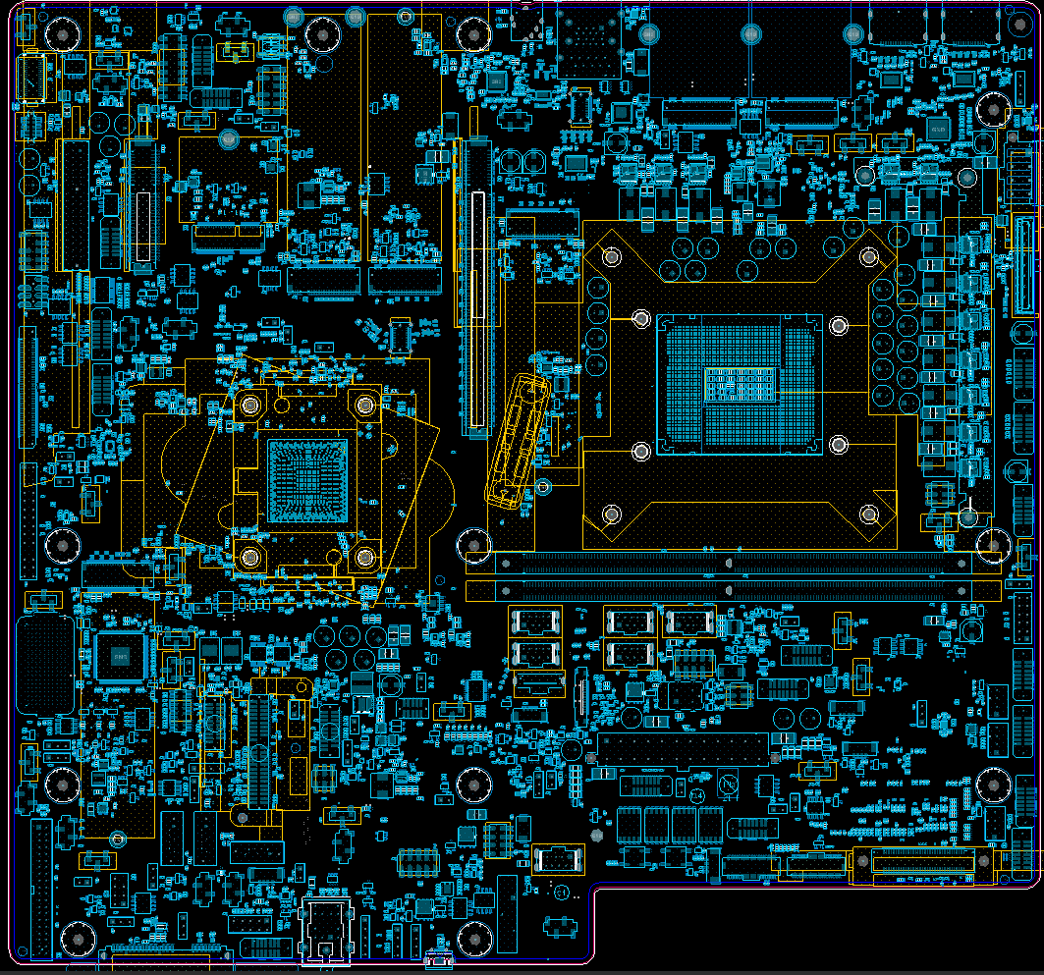
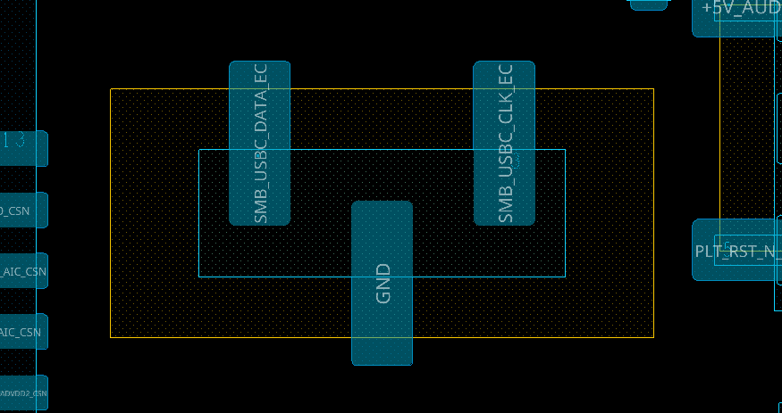
TCSS module PD Controller Programming(S01X)
J22201
1 2 3
1 | 2 | 3
SMB_USBC_DATA_EC | GND | SMB_USBC_CLK_EC

Slide 55
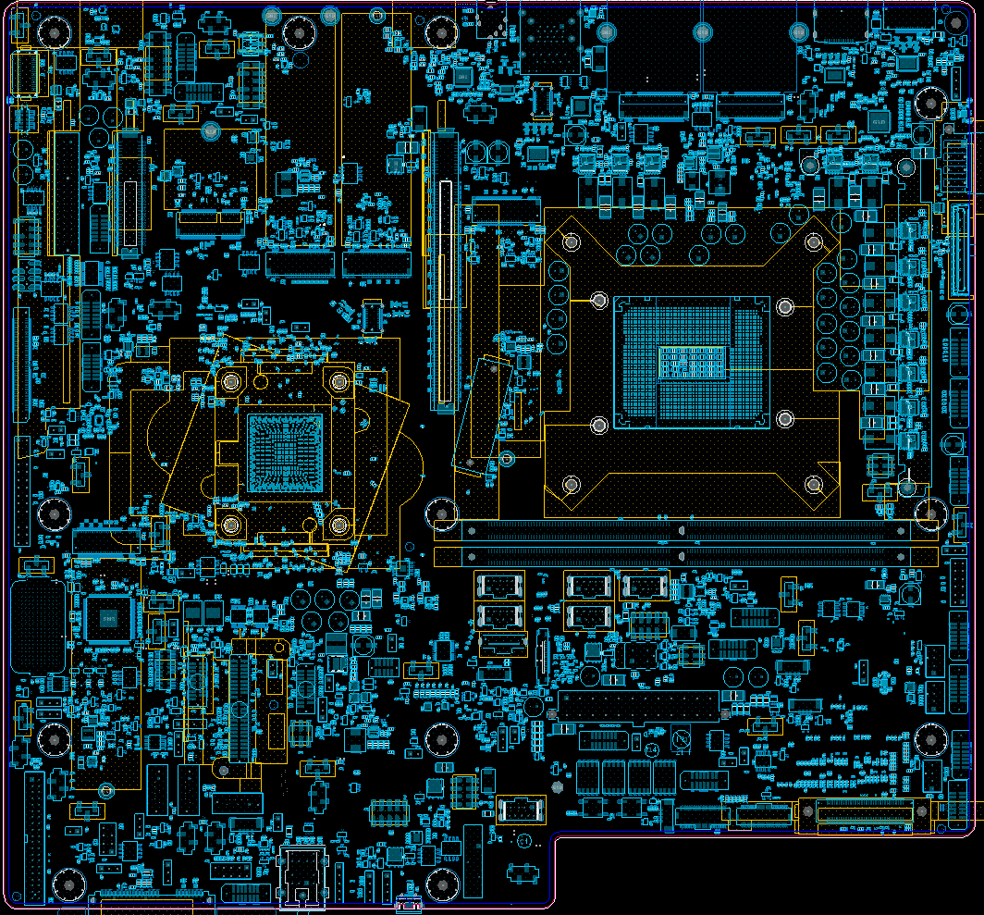
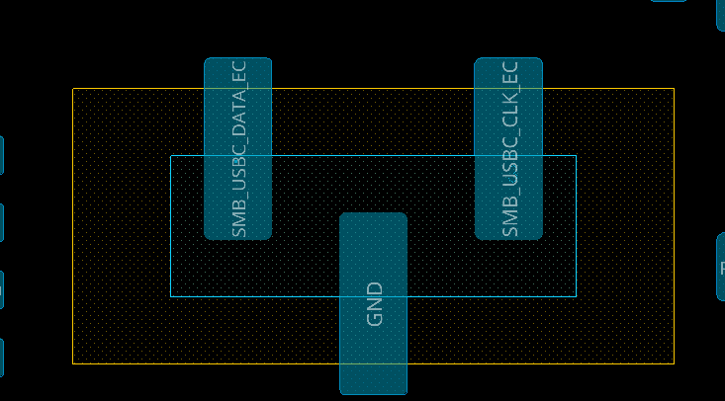
TCSS module PD Controller Programming(S02X)
J22201
1 2 3
1 | 2 | 3
SMB_USBC_DATA_EC | GND | SMB_USBC_CLK_EC

Slide 56
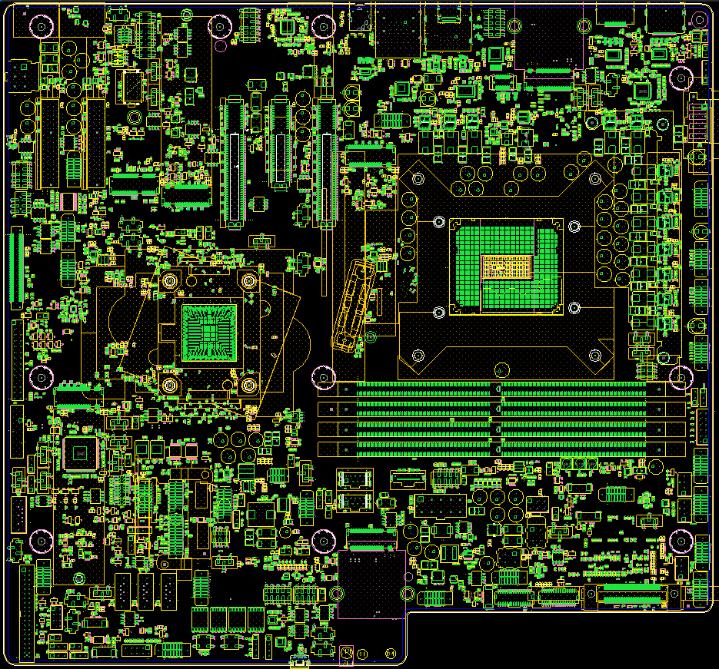
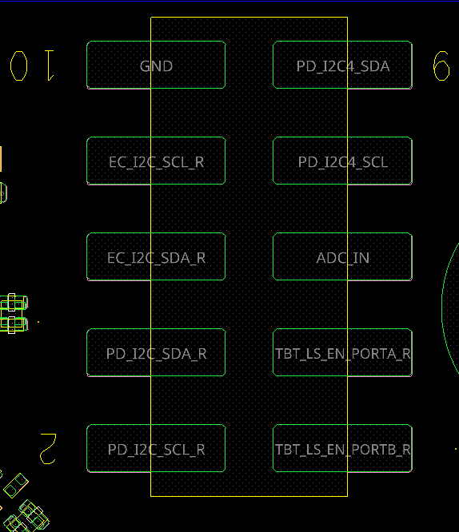
On board PD Controller Programing(S031)
J40
10
8
6
4
2
9
7
5
3
1
10 | GND | PD_I2C4_SDA (debug) | 9
8 | I2C1_SCL (EC to PD) | PD_I2C4_SCL (debug) | 7
6 | I2C1_SDA (EC to PD) | ADC_IN | 5
4 | TBT_LS_EN_PORTA_R | I2C2_SCL (TBT to PD) | 3
2 | TBT_LS_EN_PORTB_R | I2C2_SDA (TBT to PD) | 1

Slide 57
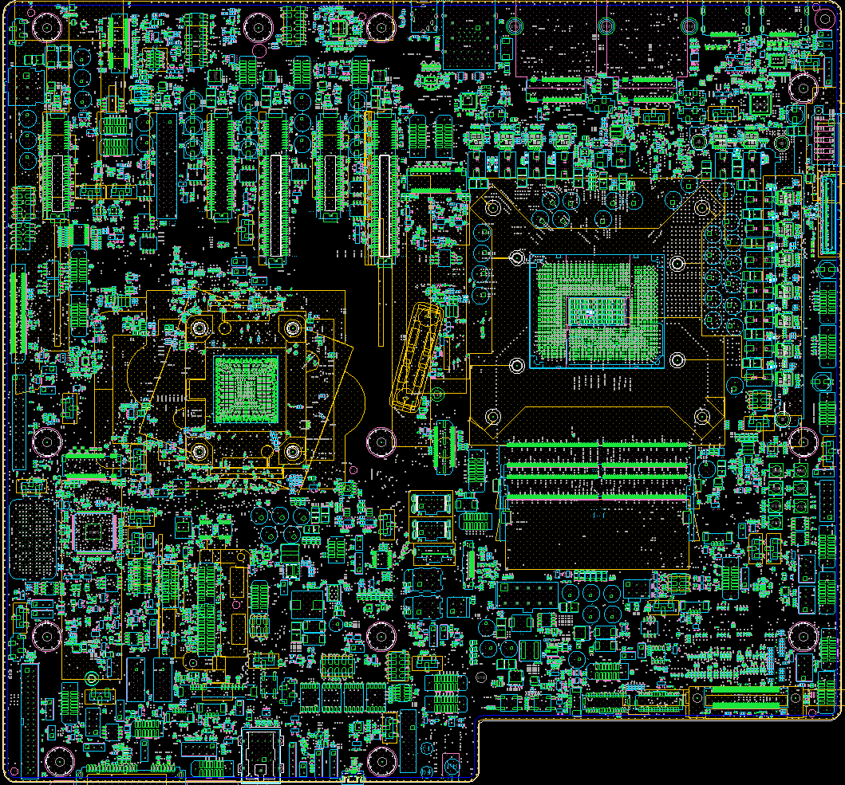
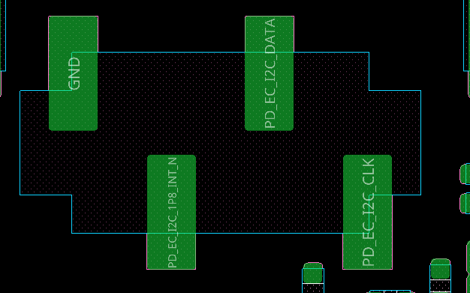
TCSS module PD Controller Programming(S041)
J22201
4 3 2 1
4 | 3 | 2 | 1
GND | PD_EC_I2C_1P8_INT_N | PD_EC_I2C_DATA | PD_EC_I2C_CLK

Slide 58
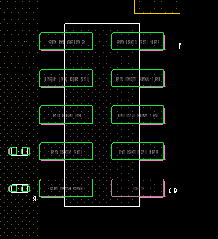
On board PD Controller Programing(S051)
1
3
5
7
9
2
4
6
8
10
J12401
1 | I2C2_SDA (TBT to PD) | TBT_LS_EN_PORTB_R | 2
3 | I2C2_SCL (TBT to PD) | TBT_LS_EN_PORTA_R | 4
5 | ADC_IN | I2C1_SDA (EC to PD) | 6
7 | PD_I2C4_SCL (debug) | I2C1_SCL (EC to PD | 8
9 | PD_I2C4_SDA (debug) | GND | 10

Slide 59
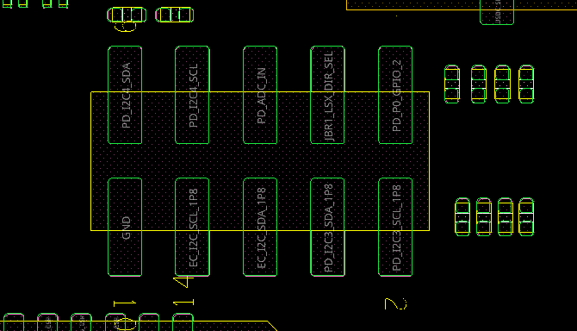
On board PD Controller Programing (S061)
9 7 5 3 1
J12401
10 8 6 4 2
9 | 7 | 5 | 3 | 1
+VCC3P3_PD_AIC | GND | ADC_IN | I2C2_SCL (TBT to PD) | I2C2_SDA (TBT to PD)
GND | I2C1_SCL (EC to PD) | I2C1_SDA (EC to PD) | I2C3_SDA (PD to others) | I2C3_SCL (PD to others)
10 | 8 | 6 | 4 | 2

Slide 60
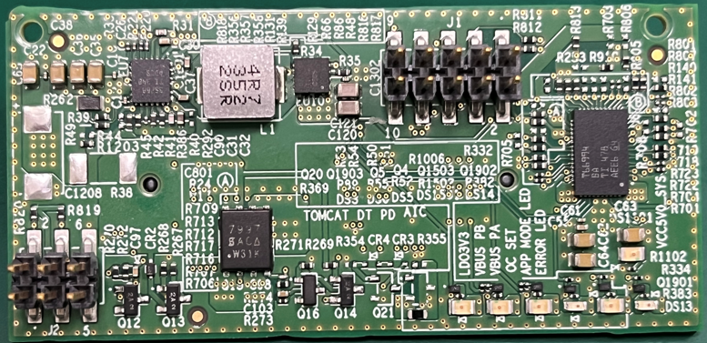
PD AIC
9 7 5 3 1
10 8 6 4 2
9 | 7 | 5 | 3 | 1
+VCC3P3_PD_AIC | GND | ADC_IN | I2C2_SCL (TBT to PD) | I2C2_SDA (TBT to PD)
GND | I2C1_SCL (EC to PD) | I2C1_SDA (EC to PD) | I2C3_SDA (PD to others) | I2C3_SCL (PD to others)
10 | 8 | 6 | 4 | 2

Slide 61
HSIO Mapping
Home

Slide 62
NVL-S RVP – USB3 Port Mapping
NVP-S PCH supports 10 USB3.2 Gen 2x1 ports
 |  | S011 / S012 /S021 / S022 NVL S DDR5 UDIMM 1DPC | S031 NVL S DDR5 UDIMM 2DPC | S041 NVL S DDR5 SODIMM 1DPC | S051 NVL S DDR5 UDIMM 1DPC OC | S061 NVL S HSIO UDIMM 1DPC
Silicon Interface | Silicon Port | EV / PPV / LEAD SKU / CPV | Delta SKU | Delta SKU | Delta SKU | HSIO (PCIe bifurcation)
USB3.2 | USB3.2 Lane#1 / Port 1 | USB3.2 Gen2x2 Vertical Type-C with re-timer/cc logic (Parade PS8825) (Rework option : Veritcal type-C port w/o retimer) | BP USB3.2 Gen2x2 Type-C with re-timer/cc logic (Analogix AN7434) | FP USB3.2 Gen2x2 Type-C with re-timer/cc logic on AIC (Parade PS8825) | BP USB3.2 Gen2x2 Type-C with re-timer/cc logic (Parade PS8825) | BP USB3.2 Gen2x2 Type-C with re-timer/cc logic (Parade PS8825)
 | USB3.2 Lane#2 / Port 2
 | USB3.2 Lane#3 / Port 3 | BP USB3.2 Gen2x1 R-A Type-A #1 with re-driver (Dual USB3 Gen2x1 + RJ45 CONN) | BP USB3.2 Gen2x1 R-A Type-A #1 with re-driver (Dual USB3 Gen2x1 + RJ45 CONN) | BP USB3.2 Gen2x1 R-A Type-A #1 with re-driver (Dual USB3 Gen2x1 + RJ45 CONN) | BP USB3.2 Gen2x1 R-A Type-A #1 with re-driver (Dual USB3 Gen2x1 + RJ45 CONN) | NC (Removal of RJ45 / USB-A connector)
 | USB3.2 Lane#4 / Port 4 | BP USB3.2 Gen2x1 R-A Type-A #2 with re-driver (Dual USB3 Gen2x1 + RJ45 CONN) | BP USB3.2 Gen2x1 R-A Type-A #2 with re-driver (Dual USB3 Gen2x1 + RJ45 CONN) | BP USB3.2 Gen2x1 R-A Type-A #2 with re-driver (Dual USB3 Gen2x1 + RJ45 CONN) | BP USB3.2 Gen2x1 R-A Type-A #2 with re-driver (Dual USB3 Gen2x1 + RJ45 CONN) | NC (Removal of RJ45 / USB-A connector)
 | USB3.2 Lane#5 / Port 5 | USB3.2 Gen2x1 Vertical Type-A #3 with re-driver (Routed on val. layer) | BP USB3.2 Gen2x1 R-A Type-A #3 with re-driver (Dual USB3 Type-A Conn) | NA (Reduction of USB Ports) | BP USB3.2 Gen2x1 R-A Type-A #3 with re-driver (Dual USB3 Type-A Conn) | BP USB3.2 Gen2x1 R-A Type-A #1 with re-driver (Dual USB3 + Dual USB2 Type-A Conn)
 | USB3.2 Lane#6 / Port 6 | USB3.2 Gen2x1 Vertical Type-A #4 with re-driver (Routed on val. layer) | BP USB3.2 Gen2x1 R-A Type-A #4 with re-driver (Dual USB3 Type-A Conn) | NA (Reduction of USB Ports) | BP USB3.2 Gen2x1 R-A Type-A #4 with re-driver (Dual USB3 Type-A Conn) | BP USB3.2 Gen2x1 R-A Type-A #2 with re-driver (Dual USB3 + Dual USB2 Type-A Conn)
 | USB3.2 Lane#7 / Port 7 | FP USB3.2 Gen2x2 Type-C with re-timer/cc logic on AIC (Parade PS8825) | FP USB3.2 Gen2x2 Type-C with re-timer/cc logic on AIC (Parade PS8825) | NA (Reduction of USB Ports) | FP USB3.2 Gen2x2 Type-C with re-timer/cc logic on AIC (Parade PS8825) | FP USB3.2 20-pin Internal Cable Header (Key-A) to Type-C w/o re-timer AIC (* connector unstuffed by default due to PCH thermal head KOZ constraint)
 | USB3.2 Lane#8 / Port 8 |  |  | NA (Reduction of USB Ports)
 | USB3.2 Lane#9 / Port 9 | USB3.2 Gen2x1 Vertical Type A #1 (w/o Redriver) | USB3.2 Gen2x1 Vertical Type A #1 (w/o Redriver) | USB3.2 Gen2x1 Vertical Type A #1 (w/o Redriver) | USB3.2 Gen2x1 Vertical Type A #1 (w/o Redriver) | FP USB3.2 20-pin Internal Cable Header (Key-B) to Type-A P-1
 | USB3.2 Lane#10 / Port 10 | USB3.2 Gen2x1 Vertical Type A #2 (w/o Redriver) | USB3.2 Gen2x1 Vertical Type A #2 (w/o Redriver) | USB3.2 Gen2x1 Vertical Type A #2 (w/o Redriver) | USB3.2 Gen2x1 Vertical Type A #2 (w/o Redriver) | FP USB3.2 20-pin Internal Cable Header (Key-B) to Type-A P-1
BP PD-less Type-C Port
FP PD-less Type-C Port
Vertical PD-less Type-C Port
BP Type-A Port
FP type-A Internal Cable Port
FP type-C Internal Cable Port
Vertical Type-A Port

Slide 63
NVL-S RVP – USB2 Port Mapping
NVP-S PCH supports 14 USB2 ports
 |  | S011 / S012 /S021 / S022 NVL S DDR5 UDIMM 1DPC | S031 NVL S DDR5 UDIMM 2DPC | S041 NVL S DDR5 SODIMM 1DPC | S051 NVL S DDR5 UDIMM 1DPC OC | S061 NVL S HSIO UDIMM 1DPC
Silicon Interface | Silicon Port | EV / PPV / LEAD SKU / CPV | Delta SKU | Delta SKU | Delta SKU | HSIO (PCIe bifurcation)
USB2 | USB2 Lane#1 / Port 1 | S-011 / S-021 BOM to PCD-S TCP[0] S-012 / S-022 BOM to Vertical Type-A (DCI) | Vertical Type-C W/O retimer of PCD-S TCP[0] (rework option: BP TCSS Module of PCD-S TCP[0]) | BP TCSS Module of PCD-S TCP[0] (via rework to Vertical Type A #1) | BP Type-C connector of PCD-S TCP[0] | BP Type-C connector of PCD-S TCP[0]
 | USB2 Lane#2 / Port 2 | S-011 / S-021 BOM to FP 10pin Header #1) S-012 / S-022 BOM to PCD-S TCP[0] | PCH PCIe CEM Slot #2 for Barlow Brown-Bear AIC (reserve only) | PCD-S PCIe CEM Slot #3 for Barlow Brown-Bear AIC (reserve only) | NC | NC
 | USB2 Lane#3 / Port 3 | Vertical Type-A #5 (for USB2.0 Port) | FP 10pin Header #1 (Dual USB2) (for USB2.0 Port) | FP USB3.2 Gen2x2 Type-C with re-timer/ cc logic on AIC (Parade PS8825) | NC | (Dual USB3 + Dual USB2 R-A Type-A #3 Conn) (for USB2.0 Port)
 | USB2 Lane#4 / Port 4 | FP 10pin Header #1 (for USB2.0 Port) | FP 10pin Header #1 (Dual USB2) (for USB2.0 Port) | BP TCSS Module of PCD-S TCP[1] (Tripad routing option) | NC | (Dual USB3 + Dual USB2 R-A Type-A #4 Conn) (for USB2.0 Port)
 | USB2 Lane#5 / Port 5 | USB3.2 Gen2x1 Vertical Type A #1 | USB3.2 Gen2x1 Vertical Type A #1 | USB3.2 Gen2x1 Vertical Type A #1 | USB3.2 Gen2x1 Vertical Type A #1 | FP USB3.2 20-pin Internal Cable Header (Key-B) to Type-A P-1
 | USB2 Lane#6 / Port 6 | TCSS Module of PCD-S TCP[1] | BP TCSS Module of PCD-S TCP[1] | USB3.2 Gen2x1 Vertical Type A #2 (Rework option: TCSS Module of PCD-S TCP[1]) | BP Type-C connector of PCD-S TCP[1] | BP Type-C connector of PCD-S TCP[1]
 | USB2 Lane#7 / Port 7 | M.2 BT (Rsvd. discrete M.2 WiFi/BT) (Rework option: FP 10pin Header #1) | M.2 BT only | M.2 BT only | M.2 BT only | NC M.2 WiFi/BT not supported
 | USB2 Lane#8 / Port 8 | BP USB3.2 Gen2x1 R-A Type-A #2 with re-driver (Dual USB3 Gen2x1 + RJ45 CONN) | BP USB3.2 Gen2x1 R-A Type-A #2 with re-driver (Dual USB3 Gen2x1 + RJ45 CONN) | BP USB3.2 Gen2x1 R-A Type-A #2 with re-driver (Dual USB3 Gen2x1 + RJ45 CONN) | BP USB3.2 Gen2x1 R-A Type-A #2 with re-driver (Dual USB3 Gen2x1 + RJ45 CONN) | NC (Removal of RJ45 / USB-A connector)
 | USB2 Lane#9 / Port 9 | USB3.2 Gen2x2 Vertical Type-C with re-timer/cc logic (Parade PS8825) (Rework option : Veritcal type-C port w/o retimer) | BP USB3.2 Gen2x2 Type-C with re-timer/cc logic (Analogix AN7434) | NC | BP USB3.2 Gen2x2 Type-C with re-timer/cc logic (Parade PS8825) | BP USB3.2 Gen2x2 Type-C with re-timer/cc logic (Parade PS8825)
 | USB2 Lane#10 / Port 10 | BP USB3.2 Gen2x1 R-A Type-A #1 with re-driver (Dual USB3 Gen2x1 + RJ45 CONN) | BP USB3.2 Gen2x1 R-A Type-A #1 with re-driver (Dual USB3 Gen2x1 + RJ45 CONN) | BP USB3.2 Gen2x1 R-A Type-A #1 with re-driver (Dual USB3 Gen2x1 + RJ45 CONN) | BP USB3.2 Gen2x1 R-A Type-A #1 with re-driver (Dual USB3 Gen2x1 + RJ45 CONN) | NC (Removal of RJ45 / USB-A connector)
 | USB2 Lane#11 / Port 11 | FP USB3.2 Gen2x2 Type-C with re-timer/ cc logic on AIC (Parade PS8825) | FP USB3.2 Gen2x2 Type-C with re-timer/ cc logic on AIC (Parade PS8825) | NC | FP USB3.2 Gen2x2 Type-C with re-timer/ cc logic on AIC (Parade PS8825) | FP USB3.2 20-pin Internal Cable Header (Key-A) to Type-C w/o re-timer AIC
 | USB2 Lane#12 / Port 12 | USB3.2 Gen2x1 Vertical Type A #2 | USB3.2 Gen2x1 Vertical Type A #2 | NC | USB3.2 Gen2x1 Vertical Type A #2 | FP USB3.2 20-pin Internal Cable Header (Key-B) to Type-A P-1
 | USB2 Lane#13 / Port 13 | USB3.2 Gen2x1 Vertical Type-A #3 with re-driver | BP USB3.2 Gen2x1 R-A Type-A #3 with re-driver (Dual USB3 Type-A Conn) | NC | BP USB3.2 Gen2x1 R-A Type-A #3 with re-driver (Dual USB3 Type-A Conn) | BP USB3.2 Gen2x1 R-A Type-A #3 with re-driver (Dual USB3 Type-A Conn)
 | USB2 Lane#14 / Port 14 | USB3.2 Gen2x1 Vertical Type-A #4 with re-driver | BP USB3.2 Gen2x1 R-A Type-A #4 with re-driver (Dual USB3 Type-A Conn) | NC | BP USB3.2 Gen2x1 R-A Type-A #4 with re-driver (Dual USB3 Type-A Conn) | BP USB3.2 Gen2x1 R-A Type-A #4 with re-driver (Dual USB3 Type-A Conn)
BP CPU Type-C Port
BP PD-less Type-C Port
BP Type-A Port
FP type-C Internal Cable Port
USB2 for Brown Bear AIC
FP PD-less Type-C Port
Vertical Type-A Port
FP type-A Internal Cable Port
FP USB2 HDR
Vertical PD-less Type-C Port
M.2 BT

Slide 64
NVL-S RVP – PCD-S PCIe/DMI Mapping
 |  | S011 / S012 / S021 / S022 UDIMM 1DPC | S031 UDIMM 2DPC | S041 SODIMM 1DPC | S051 UDIMM 1DPC OC | S061 UDIMM 1DPC HSIO
PXPA (P1) Gen5 x8 / x4+x4 | PCIe Gen5 A0 / Lane1 | M.2 NVMe SSD #1 *Boot SSD with I3C | M.2 NVMe SSD #1 *Boot SSD with I3C | x8 PCIe Gen5 CEM Slot #1 w/ Hotplug detect | M.2 NVMe SSD #1 (x4 PCIe Gen5) *Boot SSD with I3C | x8 PCIe Gen5 CEM Slot #1 w/ Hotplug detect
 | PCIe Gen5 A1 / Lane2
 | PCIe Gen5 A2 / Lane3
 | PCIe Gen5 A3 / Lane4
 | PCIe Gen5 A4 / Lane5 | M.2 NVMe SSD #2 | M.2 NVMe SSD #2 * Lane Reversal |  | M.2 NVMe SSD #2 * Lane Reversal
 | PCIe Gen5 A5 / Lane6
 | PCIe Gen5 A6 / Lane7
 | PCIe Gen5 A7 / Lane8
PXPB (P2.0 / P2.1) Gen5 x16 / x8+x8 / x4+x4+x4+x4 | PCIe Gen5 B0 / Lane9 | x16 PCIe Gen5 CEM Slot #1 w/ Hotplug detect | x8 PCIe Gen5 CEM Slot #1 w/ Hotplug detect | x8 PCIe Gen5 CEM Slot #2 w/ Hotplug detect * Riser card for x16 PCIe Test | x16 PCIe Gen5 CEM Slot #1 (PCD-S) w/ Hotplug detect (MCIO 4x4 Sideband) | x4 PCIe Gen5 CEM Slot #2
 | PCIe Gen5 B1 / Lane10
 | PCIe Gen5 B2 / Lane11
 | PCIe Gen5 B3 / Lane12
 | PCIe Gen5 B4 / Lane13 |  |  |  |  | x4 PCIe Gen5 CEM Slot #3
 | PCIe Gen5 B5 / Lane14
 | PCIe Gen5 B6 / Lane15
 | PCIe Gen5 B7 / Lane16
 | PCIe Gen5 B8 / Lane17 |  | x8 PCIe Gen5 CEM Slot #2 w/ Hotplug detect * Riser card for x16 PCIe Test | M.2 NVMe SSD #1 *Boot SSD with I3C |  | M.2 NVMe SSD #1 *Boot SSD with I3C
 | PCIe Gen5 B9 / Lane18
 | PCIe Gen5 B10 / Lane19
 | PCIe Gen5 B11 / Lane20
 | PCIe Gen5 B12 / Lane21 |  |  | x4 PCIe Gen5 CEM Slot #3 (PCD-S) * Operating at Gen4 to support Barlow Ridge AIC (dTBT) * Riser card for x16 PCIe Test |  | M.2 NVMe SSD #2 * Lane Reversal
 | PCIe Gen5 B13 / Lane22
 | PCIe Gen5 B14 / Lane23
 | PCIe Gen5 B15 / Lane24
PCIe SRC clocks & CLKREQs | SRC & CLKREQ #0 (GPP_SB_14) | CEM Slot #1 | CEM Slot #1 | CEM Slot #2 | CEM Slot #1 | CEM Slot #2
 | SRC & CLKREQ #1 (GPP_SD_6) | To Test Point | CEM Slot #2 | SSD #1 | (MCIO SB P#1) | CEM Slot #3
 | SRC & CLKREQ #2 (GPP_SD_7) | To Test Point | SSD #2 | CEM Slot #3 | (MCIO SB P#2) | SSD #1
 | SRC & CLKREQ #3 (GPP_SD_12) | To Test Point | To Test Point | To Test Point | (MCIO SB P#3) | SSD #2
 | SRC & CLKREQ #4 (GPP_SB_8) | SSD #1 | SSD #1 | CEM Slot #1 | SSD #1 | CEM Slot #1
 | SRC & CLKREQ #5 (GPP_SB_9) | SSD #2 | To Test Point | To Test Point | SSD #2 | DMI interposer
 | SRC & CLKREQ #5 (GPP_SB_7) | PCH | PCH | PCH | PCH | PCH

Slide 65
NVL-S RVP – PCH HSIO Mapping
 |  | S-01x/S-02x UDIMM 1DPC | S031 UDIMM 2DPC | S041 SODIMM 1DPC | S051 UDIMM 1DPC OC | S061 UDIMM 1DPC HSIO
PXPA (MP1) Gen4 x4 / x2+x2 / x1+x1+x1+x1 | PCIE Gen4 A0 | x2 PCIe Gen4 CEM Slot #3 * Discrete LAN AIC | x4 PCIe Gen4 CEM Slot #2 * Barlow Ridge AIC (dTBT) | M.2 NVMe SSD #4 (Bottom side) | x4 PCIe Gen4 CEM Slot #3 | x4 PCIe Gen5 CEM Slot #1 w/ Hotplug detect
 | PCIE Gen4 A1
 | PCIE Gen4 A2 / GbE LAN | Gbe LAN Jacksonville 1GbE
 | PCIE Gen4 A3 | M.2 WiFi/BT Module
PXPB (MP2) Gen4 x4 / x2+x2 / x1+x1+x1+x1 | PCIE Gen4 B0_SATA0 | M.2 NVMe SSD #4 (Bottom side) (M.2 SATA SSD, SATA0) | x2 PCIe Gen4 CEM Slot #3 *Discrete LAN AIC | SATA Direct Connect (R-A) | SATA Cable (Vertical) #1 | x4 PCIe Gen5 CEM Slot #2 * Lane Reversal
 | PCIE Gen4 B1_SATA1 |  |  | SATA Cable (Vertical) #1 | SATA Cable (Vertical) #2
 | PCIE Gen4 B2_SATA2 / GbE LAN |  | Gbe LAN Jacksonville 1GbE | SATA Cable (Vertical) #2 | SATA Cable (Vertical) #3
 | PCIE Gen4 B3_SATA3 |  | M.2 WiFi/BT Module (Std. Form-factor 2230) | ZPODD | SATA Cable (Vertical) #4
PXPC (MP3) Gen4 x4 / x2+x2 / x1+x1+x1+x1 | PCIE Gen4 C0_SATA4 | SATA Direct Connect (R-A) | SATA Cable (Vertical) #1 | x2 PCIe Gen4 CEM Slot #2 *Discrete LAN AIC | M.2 NVMe SSD #4 (Bottom side) (M.2 SATA SSD, SATA4) | x4 PCIe Gen5 CEM Slot #3 * Lane Reversal
 | PCIE Gen4 C1_SATA5 | SATA Cable (Vertical) #1 | SATA Cable (Vertical) #2
 | PCIE Gen4 C2_SATA6 / GbE LAN | SATA Cable (Vertical) #2 | SATA Cable (Vertical) #3 | Gbe LAN Jacksonville 1GbE
 | PCIE Gen4 C3_SATA7 | SATA Cable (Vertical) #3 | SATA Cable (Vertical) #4 | M.2 WiFi/BT Module (Vertical M.2, PCIe Gen3)
PXPD (P2) Gen5 x4 / x2+x2 | PCIe Gen5 D0 | x4 PCIe Gen5 CEM Slot #2 w/ Hotplug detect | M.2 NVMe SSD #4 (Bottom side) | M.2 NVMe SSD #3 (Top side) * Lane Reversal | M.2 NVMe SSD #3 (Top side) * Lane Reversal | x4 PCIe Gen5 CEM Slot #4
 | PCIe Gen5 D1
 | PCIe Gen5 D2
 | PCIe Gen5 D3
PXPE (P1) Gen5 x4 / x2+x2 / x1+x1+x1+x1 NVL PCH Gen4 capable | PCIe Gen5 E0 -> Fused to Gen4 | M.2 NVMe SSD #3 (Top side) * Lane Reversal | M.2 NVMe SSD #3 (Top side) * Lane Reversal | x4 PCIe CEM Slot #3 | x2 PCIe CEM Slot #2 *Discrete LAN AIC | x4 PCIe Gen5 CEM Slot #5
 | PCIe Gen5 E1 -> Fused to Gen4
 | PCIe Gen5 E2 -> Fused to Gen4 |  |  |  | Foxville (i226LM) 2.5GbE
 | PCIe Gen5 E3 -> Fused to Gen4 |  |  |  | M.2 WiFi/BT Module
PXPF (P3) Gen5 x4 / x2+x2 / x1+x1+x1+x1 | PCIe Gen5 F0 | M.2 NVMe SSD #5 (Top side) * Lane Reversal | x4 PCIe Gen5 CEM Slot #1 w/ Hotplug detect * Riser card for x16 PCIe Test | x4 PCIe Gen5 CEM Slot #1 w/ Hotplug detect * Riser card for x16 PCIe Test | x4 PCIe Gen5 CEM Slot #1 w/ Hotplug detect * Riser card for x16 PCIe Test | x4 PCIe Gen5 CEM Slot #6
 | PCIe Gen5 F1
 | PCIe Gen5 F2
 | PCIe Gen5 F3
PCIe SRC clocks & CLKREQs | CLKOUT_PCH_SRC #0 [Gen4] | Gbe LAN Jacksonville | Gbe LAN Jacksonville | Gbe LAN Jacksonville | (Foxville i226LM) on board | CEM Slot #1
 | CLKOUT_PCH_SRC #1 [Gen4] | M.2 WiFi/BT Module | M.2 WiFi/BT Module | M.2 WiFi/BT Module | M.2 WiFi/BT Module | CEM Slot #2
 | CLKOUT_PCH_SRC #2 [Gen4] | To Test Point | To Test Point | To Test Point | To Test Point | CEM Slot #3
 | CLKOUT_PCH_SRC #3 [Gen4] | To Test Point | To Test Point | To Test Point | To Test Point | MCIO connector #1
 | CLKOUT_PCH_SRC #4 [Gen5] | To Test Point | To Test Point | To Test Point | To Test Point | MCIO connector #2
 | CLKOUT_PCH_SRC #5 [Gen5] | To Test Point | To Test Point | To Test Point | To Test Point | MCIO connector #3
 | CLKOUT_PCH_SRC #6 [Gen5] | SSD #5 | CEM Slot #1 | CEM Slot #1 | CEM Slot #1 | CEM Slot #4
 | CLKOUT_PCH_SRC #7 [Gen5] | CEM Slot #2 | CEM Slot #2 | CEM Slot #2 | CEM Slot #2 | CEM Slot #5
 | CLKOUT_PCH_SRC #8 [Gen5] | CEM Slot #3 | CEM Slot #3 | CEM Slot #3 | CEM Slot #3 | CEM Slot #6
 | CLKOUT_PCH_SRC #9 [Gen5] | SSD #3 | SSD #3 | SSD #3 | SSD #3 | MCIO connector #4
 | CLKOUT_PCH_SRC #10 [Gen5] | SSD #4 | SSD #4 | SSD #4 | SSD #4 | MCIO connector #4
 | CLKOUT_PCH_SRC #11 [Gen5] | (MCIO SB P#1) | (MCIO SB P#1) | To 1x3 HDR | To 1x3 HDR | MCIO connector #3

Slide 66
NVL-S RVP – Clock Block Diagram
*
*
* BCLK OC INJ , PEG/DMI OC INJ connected to Ext. CLK Gen. on S-051 OC RVP only , other SKUs are connected to SMP connectors
PCIe CLK/CLKREQ# are dependent on board SKUs, Please have the detail in following 2 pages

Slide 67
NVL-S RVP – PCD-S SRC Clock Mapping
There are total 7 PCD-S SRC CLK & CLKREQ signals, one is dedicated to DMI. All Gen5 capable CLKs
CLK and CLKREQ# number are 1:1 mapped in all NVL-S RVP SKUs.
 | S01x/S-02x UDIMM 1DPC | S031 UDIMM 2DPC | S041 SODIMM 1DPC | S051 OC | S061 HSIO
CLKREQ #0 (GPP_SB_14) | x16 PCIe Gen5 CEM Slot #1 | x8 PCIe Gen5 CEM Slot #1 (PCD-S) | x8 PCIe Gen5 CEM Slot #2 (PCD-S) | x16 PCIe Gen5 CEM Slot #1 (PCD-S) | x8 PCIe Gen5 CEM Slot #2 (PCD-S)
CLKREQ #1 (GPP_SD_6) |  | x8 PCIe Gen5 CEM Slot #2 (PCD-S) | M.2 NVMe SSD #1 | MCIO SB P#1 | x8 PCIe Gen5 CEM Slot #3 (PCD-S)
CLKREQ #2 (GPP_SD_7) |  | M.2 NVMe SSD #2 | x4 PCIe Gen4 CEM Slot #3 (PCD-S) | MCIO SB P#2 | M.2 NVMe SSD #1
CLKREQ #3 (GPP_SD_12) |  |  |  | MCIO SB P#3 | M.2 NVMe SSD #2
CLKREQ #4 (GPP_SB_8) | M.2 NVMe SSD #1 | M.2 NVMe SSD #1 | x8 PCIe Gen5 CEM Slot #1 (PCD-S) | M.2 NVMe SSD #1 | x8 PCIe Gen5 CEM Slot #1 (PCD-S)
CLKREQ #5 (GPP_SB_9) | M.2 NVMe SSD #2 |  |  | M.2 NVMe SSD #2 | DMI interposer
DMI CLK & CLKREQ # (GPP_SB_7) | PCH

Slide 68
NVL-S RVP – PCH SRC Clock Mapping
There are total 12 PCH CLK & CLKREQ signals. 0~3 are Gen4 capable, others are Gen5
CLK and CLKREQ# number are 1:1 mapped in all NVL-S RVP SKUs
MCIO SB#2, #3 are rework options in S-01x/02x/031
CLK & CLKREQ# | S01x/S02 x UDIMM 1DPC | S031 UDIMM 2DPC | S041 SODIMM 1DPC | S051 OC | S061 HSIO
CLKREQ #0 (GPP_C_3) | Gbe LAN Jacksonville | Gbe LAN Jacksonville | Gbe LAN Jacksonville | Foxville i226LM | x4 PCIe Gen4 CEM Slot #1 (PCH)
CLKREQ #1 (GPP_C_4) | M.2 WiFi/BT Module / MCIO SB #2 | M.2 WiFi/BT Module / MCIO SB #2 | M.2 WiFi/BT Module | M.2 WiFi/BT Module | x4 PCIe Gen4 CEM Slot #2 (PCH)
CLKREQ #2 (GPP_C_6) |  |  |  |  | x4 PCIe Gen4 CEM Slot #3 (PCH)
CLKREQ #3 (GPP_R_6) |  |  |  |  | MCIO SB #1
CLKREQ #4 (GPP_R_7) |  |  |  |  | MCIO SB #2
CLKREQ #5 (GPP_R_8) |  |  |  |  | MCIO SB #3 P1
CLKREQ #6 (GPP_E_9) | M.2 NVMe SSD #5 | x4 PCIe Gen5 CEM Slot #1 (PCH) | x4 PCIe Gen5 CEM Slot #1 (PCH) | x4 PCIe Gen5 CEM Slot #1 (PCH) | x4 PCIe Gen5 CEM Slot #4 (PCH)
CLKREQ #7 (GPP_E_10) | x4 PCIe Gen5 CEM Slot #2 (PCH) | x4 PCIe Gen4 CEM Slot #2 (PCH) | x2 PCIe Gen4 CEM Slot #2 (PCH) | x2 PCIe Gen5 CEM Slot #2 (PCH) | x4 PCIe Gen5 CEM Slot #5 (PCH)
CLKREQ #8 (GPP_H_1) | x2 PCIe Gen4 CEM Slot #3 (PCH) / MCIO SB #3 | x2 PCIe Gen4 CEM Slot #3 (PCH) / MCIO SB P#3 | x4 PCIe Gen5 CEM Slot #3 (PCH) | x4 PCIe Gen4 CEM Slot #3 (PCH) | x4 PCIe Gen5 CEM Slot #6 (PCH)
CLKREQ #9 (GPP_H_2) | M.2 NVMe SSD #3 | M.2 NVMe SSD #3 | M.2 NVMe SSD #3 | M.2 NVMe SSD #3 | MCIO SB #4 P1
CLKREQ #10 (GPP_H_3) | M.2 NVMe SSD #4 | M.2 NVMe SSD #4 | M.2 NVMe SSD #4 | M.2 NVMe SSD #4 | MCIO SB #4 P2
CLKREQ #11 (GPP_H_4) | MCIO SB #1 | MCIO SB #1 |  |  | MCIO SB #3 P2

Slide 69
STORAGE
Home

Slide 70
NVL-S RVP – Storage Interface & Port Mapping
(S011 / S012 / S021 / S022)
NIST Recovery w/ I3C
No. | Interface | Storage Description
1 | M.2 SATA SSD | Share the same M.2 2280 connector
2 | M.2 NVMe SSD
3 | PCIe NAND SSD | Use PCIe to M.2 adapter board
4 | SD CARD over PCIe | Bayhub PCIe to SD Card reader (Through PCIe slot)
5 | SATA Direct Conn | HDD/SSD
6 | SATA Cable Conn | HDD

Slide 71
NVL-S RVP – Storage Interface & Port Mapping
(S-031)
NIST Recovery w/ I3C
No. | Interface | Storage Description
1 | M.2 NVMe SSD | Share the same M.2 2280 connector
2 | PCIe NAND SSD | Use PCIe to M.2 adapter board
3 | SD CARD over PCIe | Bayhub PCIe to SD Card reader (Through PCIe slot)
4 | SATA Cable Conn | HDD

Slide 72
NVL-S RVP – Storage Interface & Port Mapping
(S-041)
NIST Recovery w/ I3C
No. | Interface | Storage Description
1 | M.2 NVMe SSD | Share the same M.2 2280 connector
2 | PCIe NAND SSD | Use PCIe to M.2 adapter board
3 | SD CARD over PCIe | Bayhub PCIe to SD Card reader (Through PCIe slot)
4 | SATA Direct Conn | HDD/SSD
5 | SATA Cable Conn | HDD
6 | SATA ODD Cable Conn | ZPODD

Slide 73
NVL-S RVP – Storage Interface & Port Mapping
(S-051)
NIST Recovery w/ I3C
No. | Interface | Storage Description
1 | M.2 SATA SSD | Share the same M.2 2280 connector
2 | M.2 NVMe SSD
3 | PCIe NAND SSD | Use PCIe to M.2 adapter board
4 | SD CARD over PCIe | Bayhub PCIe to SD Card reader (Through PCIe slot)
5 | SATA Cable Conn | HDD

Slide 74
NVL-S RVP – Storage Interface & Port Mapping
(S-061)
NIST Recovery w/ I3C
No. | Interface | Storage Description
1 | M.2 NVMe SSD | Use PCIe to M.2 adapter board
2 | PCIe NAND SSD | Use PCIe to M.2 adapter board
3 | SD CARD over PCIe | Bayhub PCIe to SD Card reader (Through PCIe slot)

Slide 75
Connectivity
Home

Slide 76
Overview- Connectivity (S-01/02/03/04)
Interface Name | Module Name | Remarks
Integrated CNVio3 /STEP | Whale Peak2 / Spider Peak2 | M.2-1A Key E Socket 1
Discrete WLAN+BT | Gale Peak2 / Misty Peak2 | M.2-1A Key E Socket 1
1GbE LAN | Jacksonville | RJ-45 Jack
2.5G LAN | FoxVille vPRO | Only supported via PCIe AIC

Slide 77
Overview- Connectivity (S-051)
Interface Name | Module Name | Remarks
Integrated CNVio3 /STEP | Whale Peak2 / Spider Peak2 | M.2-1A Key E Socket 1
Discrete WLAN+BT | Gale Peak2 / Misty Peak2 | M.2-1A Key E Socket 1
2.5G LAN | FoxVille (i226-LM) | RJ-45 Jack
2.5G LAN | FoxVille vPRO | Only supported via PCIe AIC

Slide 78
Connectivity of WLAN
Description | Interface Name/ Signal Name | Support on NVL-S RVP
WIFI | PCIe CNVio3 (STEP) CLINK(CSME) | Yes
BT DATA | USB2.0 PCIe | Yes
WLAN M.2 Control | BRI (integrate module, BT) RGI (integrate module, WiFi) CRF_RST CRF_CLKREQ WIFI_RFKILL# BT_RFKILL#1 WLAN_LED# BT_LED# | Yes
BT AUDIO | I2S (PCM) | Yes
RF Coexistence | MFUART2_RX MFUART2_TX UART supports Real-Time Coexistence | No
WLAN Connector Type | Description | SKU
Right-angle/4.2mm/M2-1A | M88859-001 | S02X/01X/031/051
Vertical/M2-1A | N57633-001 | S041

Slide 79
AUDIO
Home

Slide 80
NVL-S RVP Audio Overview
NVL-S RVP enables value system with single-chip audio solution. On board codec upgraded to ALC722-CG [SDCA 0.8] compliant Soundwire based codec default configured using SNDW3 multilane port across all the RVP SKUs.
RVP supports different audio codec validation through add-in-card solution. Realtek AIOC GEN6 is the POR AIC for Soundwire & Realtek AIOC GEN4.1 to support HDA [ALC897] validation.
Notes:
Reference :
Gen 6 Audio Add-In-Card - Reference Validation Platform Design Wiki - Intel Enterprise Wiki
Cirrus AIOC v3 - Reference Validation Platform Design Wiki - Intel Enterprise Wiki
Gen3 Audio Add-In-Card - Reference Validation Platform Design Wiki - Intel Enterprise Wiki
Gen4 Audio Add-In-Card - Reference Validation Platform Design Wiki - Intel Enterprise Wiki

Slide 81
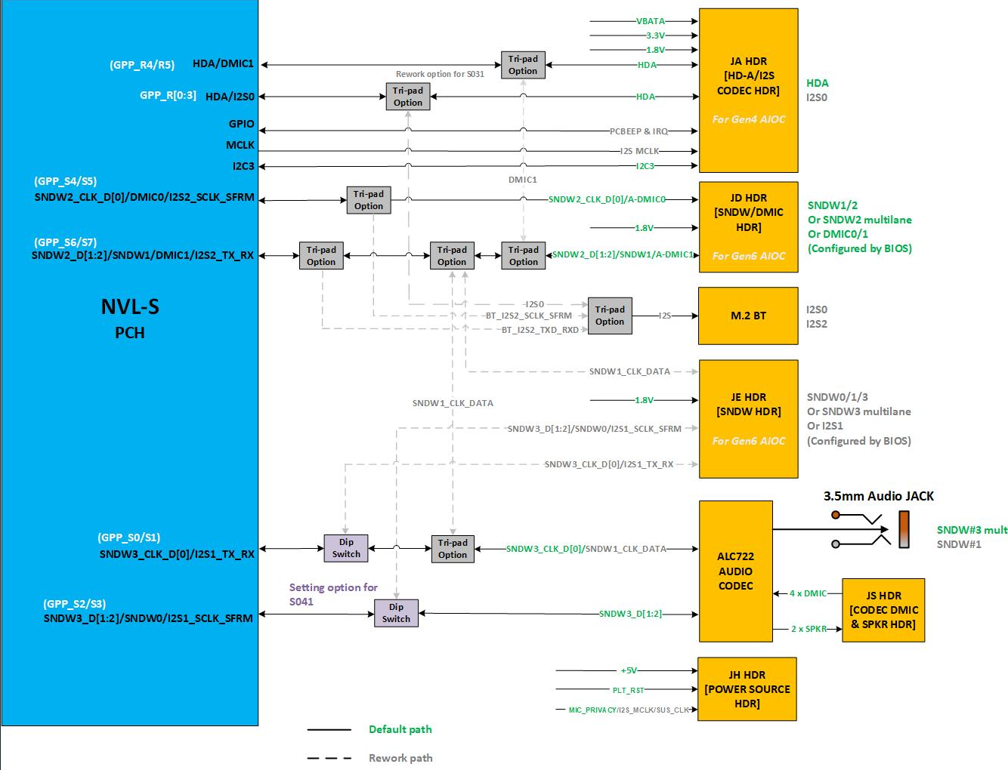
NVL-S RVP- Audio Block Diagram

Slide 82
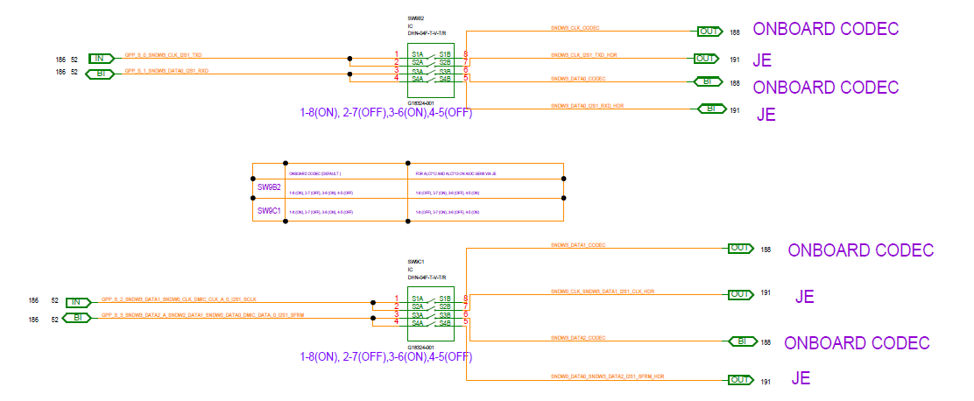
Audio Switch Definition
SNDW Switching between Onboard Codec & AIOC Gen6 Card :
SW9B2 and SW9C1 to switch onboard codec and Gen6 SNDW card
Default setting Onboard Codec: 1-8(ON), 2-7(OFF), 3-6(ON), 4-5(OFF)
AIOC Gen6 Card (F-06): 1-8(OFF), 2-7(ON), 3-6(OFF), 4-5(ON)

Slide 83
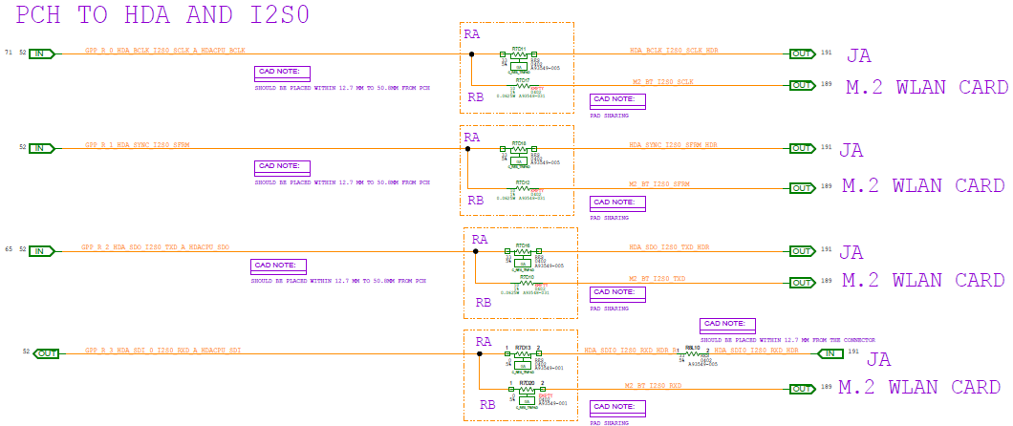
Tri-pad Rework for HDA and I2S0
HDA and I2S0 are sharing the same pins, below tripads are JA (HDA) and BT audio offload (I2S0) selection
S01X/02X/041/051 default path is JA (HDA)
S031 default path is I2S0 to M.2 WLAN slot for BT Audio offload, need to conduct tripad rework (F-07) for HDA

Slide 84
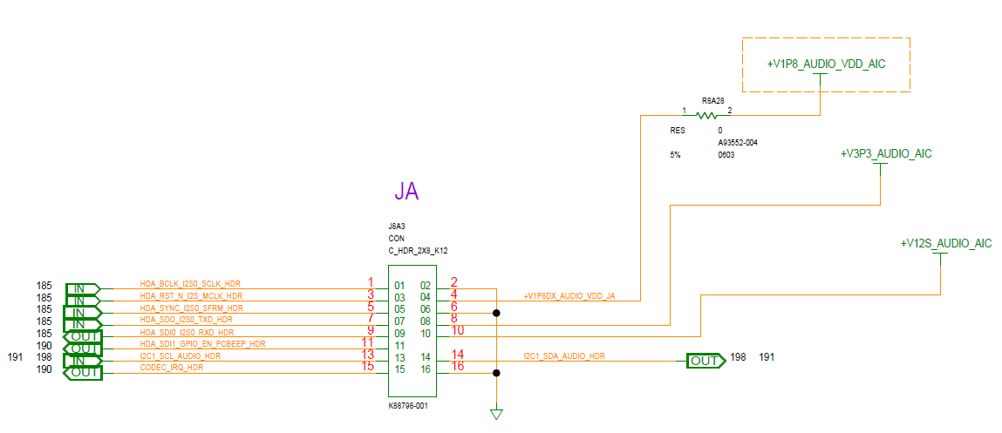
Audio Headers Definition
JA - Header [HDA/I2S0] :
JA header is used to provide clock & data transmission in HDA mode & I2S mode.
For HDA mode, Realtek GEN4.1 AIC (ALC897) will be used along with the transducer card.
In SNDW mode, it will be used as power source for AIC. Refer below snap for the header pinout details.

Slide 85
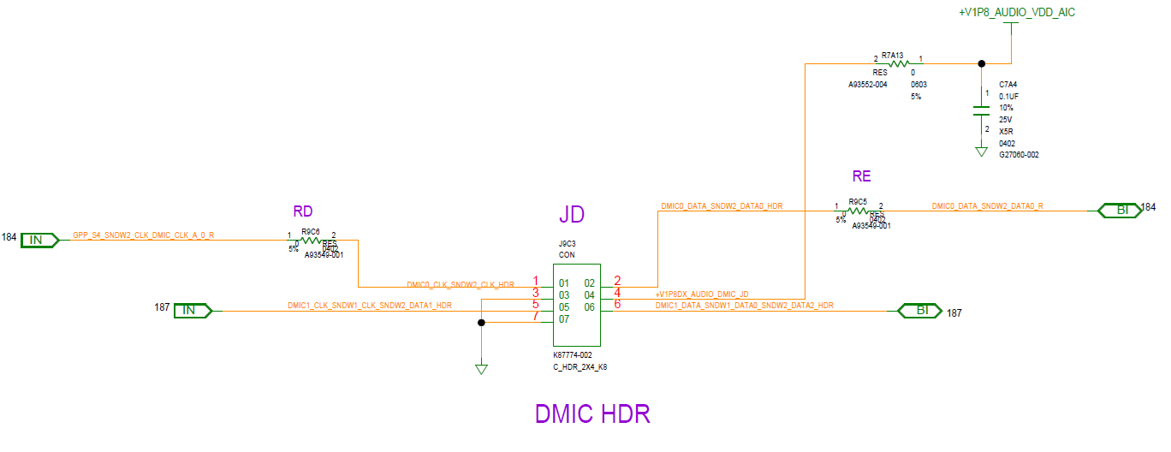
JD – Header [SNDW/DMIC] :
The JD header is default configured in SNDW mode to drive 2-SPKR/4-SPKR using ALC1320 stereo amplifier codecs on Realtek AIOC GEN6
The header can be configured to connect 4xDMIC’s directly (via Transducer card) with BIOS settings enabled.

Slide 86
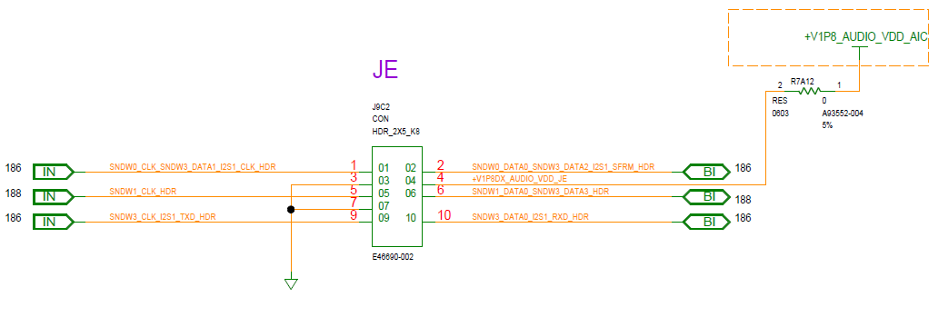
JE Header [SNDW/I2S1] :
The JE header can be used to drive ALC712-VB full function codec or ALC713-VB UAJ codec using SNDW3 multilane port on Realtek GEN6 AIC.

Slide 87
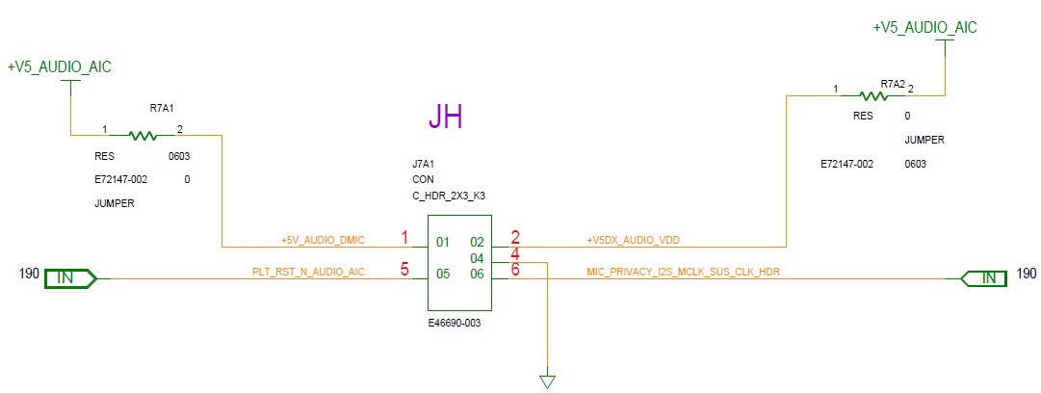
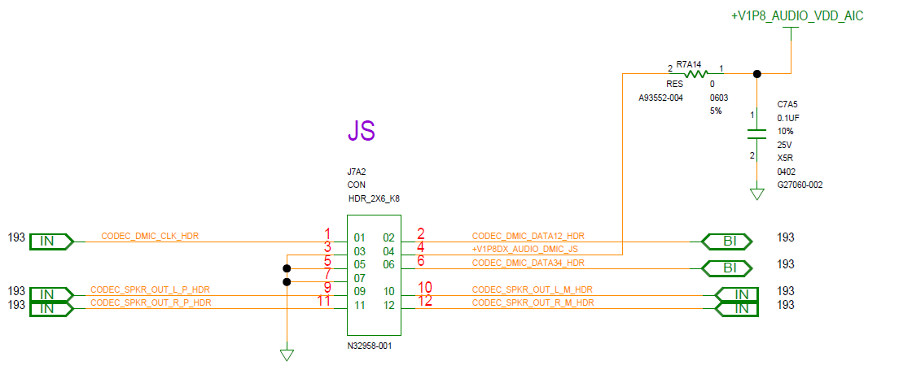
JH – Header :
JH header will be used as 5V power source in 4-SPKR/6-SPKR configuration.
PLT_RST_N is routed additionally so that when AIOC is powered from external supply and power recycle is done for RVP, PLT_RST_N can be used to ensure AIOC power recycle in such cases.
It also provides, SUS_CLK connection as always-on-clock for future use (Smart DMIC use-cases).
JS – Header :
JS header is used to connect on-board ALC722 codec DMIC and SPKR load using Y-cable on transducer AIC. It can drive 4xDMIC & 2 SPKR’s.

Slide 88


S01X/S02X Audio HDR’s Board Placement
JH
JA
JS
JE
SW9B2
JD
SW9C1
TOP SIDE

Slide 89


S031 Audio HDR’s Board Placement
JA
SW9B2
SW9C1
JS
JH
JE
JD
TOP SIDE

Slide 90


S041 Audio HDR’s Board Placement
JS
JA
JH
JE
SW9B2
SW9C1
JD
TOP SIDE

Slide 91


S051 Audio HDR’s Board Placement
JS
JE
JH
JD
JA
SW9B2
SW9C1
TOP SIDE

Slide 92

Audio Privacy Microphone Protection
NVL-S RVP uses SoC pins MIC_MUTE and MIC_MUTE_LED to support microphone privacy protection
The HW will take in a privacy signaling input from the GPIO pin (which typically connects to a mic disable switch), indicating the current user privacy mode setting on the system. It also turns on a privacy indicator output through the GPIO pin (which typically connects to a privacy LED).

Slide 93
SPI and eSPI
Home

Slide 94
Block Diagram - SPI and eSPI
SPI Flash part :
WINBOND 64MB RPMC, 50MHz and 100MHz
1.8V : W25R512NWEIQ (BOM Default)
3.3V : W25R512JVEIN (Rework option)
F-17 : 3.3V flash Enablement
MAF/SAF/G3 sharing configuration in NVL-S RVP SKUs.
Default stuffed on S031 only
Flash-1 and damping R stuffed on S011 only
 | S021/S011 | S031 | S041 | S051 | S061
G3 Sharing | Default |  | F-10 | Default | Default
MAF | F-10 |  | Default | F-10 | F-10
SAF | F-10 |  | F-10 | F-10 | F-10
SAF+dTPM | F-10 | Default |  | F-10
Only stuff on S011 and S041

Slide 95
LPSS
Home

Slide 96
LPSS Interfaces List
NVP-S PCH supports below LPSS signals.
SPI0
eSPI
2* THC[0:1]
3* UART[0:2]
3* GSPI[0:2]
3* LPSS I3C[0:2]
6* LPSS I2C[0:5]
1* ISH I3C[0]
3* ISH I2C[0:2]
1* SMBUS
6* SML[0:4] / 0B / USBC
1* MLink

Slide 97
SPI , THC, eSPI, UART, GSPI Mapping
SKU | S011 UDIMM 1DPC | S021 UDIMM 1DPC | S031 UDIMM 2DPC | S041 SODIMM 1DPC | S051 UDIMM 1DPC OC | S061 HSIO UDIMM 1DPC
Interface | Device | Device | Device | Device | Device | Device
SPI0 FLASH | 50MHz 64MB Flash-0 |  |  | 100MHz 64MB Flash-0 | 50MHz 64MB Flash-0
 | 50MHz 64MB Flash-1 | 50MHz 64MB Flash-1 |  | NA | 50MHz 64MB Flash-1
 | SF600 TPM Header
 | Dedicated TPM Header |  | Dedicated TPM Header | NA | Dedicated TPM Header
 | TTK3 Header | TTK3 Header | TTK3 Header | TTK3 Header | TTK3 Header | TTK3 Header
THC0_SPI / THC0_I2C | THC validation header |  | NA | THC validation header | NA
THC1_SPI / THC1_I2C | Touch Panel |  | NA | Touch Panel | NA
eSPI | EC
 | eSPI header
 | MECC | MECC | NA | MECC | MECC | NA
SKU | S011 UDIMM 1DPC | S021 UDIMM 1DPC | S031 UDIMM 2DPC | S041 SODIMM 1DPC | S051 UDIMM 1DPC OC | S061 HSIO UDIMM 1DPC
Interface | Device | Device | Device | Device | Device | Device
UART0 | LPSS CONN
UART1 | LPSS CONN
UART2 | CP2105 SERIAL LOG
 | TTK3
SKU | S011 UDIMM 1DPC | S021 UDIMM 1DPC | S031 UDIMM 2DPC | S041 SODIMM 1DPC | S051 UDIMM 1DPC OC | S061 HSIO UDIMM 1DPC
Interface | Device | Device | Device | Device | Device | Device
GSPI0 | LPSS CONN | LPSS CONN |  |  |  | NA
GSPI1 | LPSS CONN | LPSS CONN |  |  |  | NA
GSPI2 | LPSS CONN |  |  |  |  | NA
Note:
Red indicates the rework was needed

Slide 98
LPSS I2C Devices Mapping
SKU | S011 UDIMM 1DPC | S021 UDIMM 1DPC | S031 UDIMM 2DPC | S041 SODIMM 1DPC | S051 UDIMM 1DPC OC | S061 HSIO UDIMM 1DPC
Interface | Device | Device | Device | Device | Device | Device
LPSS I2C0 /I3C0 | SPD
 | LPSS CONN | LPSS CONN |  |  |  | NA
LPSS I2C1/ I3C1 | LPSS CONN | LPSS CONN |  |  |  | NA
 | AUDIO JA HEARDER (I2C)
 | I3C HDR |  | I3C EV HDR | NA
LPSS I2C2/ I3C2 | LPSS CONN | LPSS CONN |  |  |  | NA
 | I2C EV HDR |  | I2C EV HDR | NA
LPSS I2C3 | LPSS CONN |  |  |  |  | NA
LPSS I2C4 | LPSS CONN | LPSS CONN |  |  |  | NA
 | PSS
 | TTK3
 | PD controller (Reserve for EC-less) |  | NA | PD controller (Reserve for EC-less) | NA
LPSS I2C5 | LPSS CONN | LPSS CONN
 | DP retimer |  |  |  | NA
 | HDMI redriver |  |  | NA |  | HDMI retimer
 | Power Monitor |  |  |  |  | NA
 | Port80/IO Expander (Reserve for EC-less) |  | NA | EC devices (Reserve for EC-less) | NA
ISH I2C0 /I3C0 | Mosaic (I3C) |  | Mosaic (I3C) | Mosaic (I3C) |  | NA
 | Mosaic (I2C) |  |  |  |  | NA
 | I3C HDR |  | I3C EV HDR | NA | NA | NA
 | TTK3 |  |  |  |  | NA
 | EC |  | NA | EC | NA
ISH I2C1 | Mosaic |  | Mosaic | Mosaic |  | NA
 | I2C EV HDR |  |  | NA
ISH I2C2 | Mosaic |  | Mosaic | Mosaic |  | NA
Note:
Red indicates the rework is needed
Note:
Red indicates the rework was needed ; S08 has no these signals.

Slide 99
SMBUS, SMLINK, MLINK Mapping
SKU | S011 UDIMM 1DPC | S021 UDIMM 1DPC | S031 UDIMM 2DPC | S041 SODIMM 1DPC | S051 UDIMM 1DPC OC | S061 HSIO UDIMM 1DPC
Interface | Device | Device | Device | Device | Device | Device
SMBUS | SPD
 | MIPI60 header
 | eSPI header
 | FRU EEPROM
 | TTK3
 | PM sideband header
 | 1x4 Header
 | USBC 5V VR
 | PCIe slots
 | VR override
 | IMVP
SMLink 0 | LPSS CONN | LPSS CONN |  |  |  | NA
 | 1x3 Header
 | PCIe slot |  |  |  |  | NA
 | Gbe LAN Jacksonville | Gbe LAN Jacksonville | Gbe LAN Jacksonville | Gbe LAN Jacksonville | Foxville LAN | NA
 | JBR retimer
SMLink 0B | LPSS CONN | LPSS CONN |  |  |  | NA
SMLink 1 | LPSS CONN | LPSS CONN |  |  |  | NA
 | 1x3 Header
 | PM SIDEBAND HEADER
SMLink 2 | LPSS CONN | LPSS CONN |  |  |  | NA
 | EC
SMLink 3 | LPSS CONN | LPSS CONN |  |  |  | NA
SMLink 4 | LPSS CONN | LPSS CONN |  |  |  | NA
USBC_SML | BP PD-less Retimer |  |  | NA | BP PD-less Retimer
 | FP PD-Less Retimer
 | TCSS module |  | On board Tomcat PD | TCSS module | On board Sky Warrior PD | On board Sky Warrior PD
 | 1X4 HEADER
MLink | CONNECTIVITY - M.2 KEY-E CONNECTOR - WLAN/BT
 | MLINK HEADER
Note:
Red indicates the rework is needed

Slide 100

Address table of LPSS
For checking the address of each device, please visit PDT share point from below link.
RVP GPIO mapping table
In the mapping table, you can find the LSIO relevant tabs and can see the detail table like below.

Slide 101

LPSS AIC
The picture shows the supported signal on LPSS connector.
Can refer to LPSS user guide from below link.
LPSS AIC user guide

Slide 102
Sensors and Sensor AIC
Home

Slide 103
Block Diagram – Sensors and Sensor AIC
NVP-S
Mosaic GEN 3 HDR
1.8V
3.3V
ISH I2C0 /I3C0
Level Shifter
ISH_I3C0
ISH_I2C0
ISH I2C1
3.3V
1.8V
3.3V
ISH I2C2
Level Shifter
ISH SPI
1.8V
ISH GPIOs (0-7, 10)
3.3V
ISH UART1
3.3V
2x3 HDR
ISH UART0
Note:
Solid line indicates default support on the board. Dotted lines indicate the need for rework.

Slide 104
Mosaic GEN 3 BOM details
Sensors | BOM1 | BOM2
3-axis Accelerometer | Bosch BMI323 (I3C) | ST LSM6DSV256 (I3C, Low-G)
3-axis Magnetometer | Memsic MMC5633NJ (I3C) | AKM AK9919C (I3C)
3-axis Gyroscope | Bosch BMI323 (I3C) | ST LSM6DSV256 (I3C)
2nd Accelerometer | BMA530 | ST LIS2DW12
Additional Accelerometer |  | ST LSM6DSV256 (I3C, High-G)
Barometer/Altimeter |  | ST LPS22DF
HAL switch | Rohm BU52072GWZ | Rohm BU52072GWZ
Short Distance Proximity (to 30cm) | VCNL4030
ALS | VCNL4030
RGB/XYZ |  | AMS TCS3410
SAR - Proximity | Semtech Sx9331 | Semtech Sx9331
TOF sensor | STM VL53L8
Radar for Human Presence |  | Infineon BGT60TR13C
Humidity
Temperature
Vision Sensor | NA
Note:
Please refer to sheet “ISH” in the platform mapping document for detail device address, ISH_GPIO usage, interfaces for each sensors

Slide 105
Embedded Controller
Home

Slide 106

Embedded controller - Block Diagram
NVL-S RVP will support Nuvoton NPCX4885A0DX (128-pin LQFP package) Embedded Controller onboard.

Slide 107
Power Delivery Implementation Details
Home

Slide 108
PSU
NVL-S supports only one power source from ATX PSU to boot RVP boards
For Multi-Rails PSU,
Please refer to the Intel Power Supply Selector Link to order from the marketing directly.(recommend to purchase tested as newer as possible)
For Signal-Rail PSU
FSP750-27SCB used for MTL-S/ARL-S can be reused on NVL-S.
FSP850-27ARB can be ordered in demand call.
Other details– Link
Note
1. Please ensure all power cables are plugged in properly.
2. S051 OC board has two 12V 2x4 power connectors for CPU. Please ensure both two power cables are plugged in properly.
Board type | S-01x_UDIMM-1DPC EVERB/EVCRB/PPV | S-02x_UDIMM-1DPC CRB/CPV | S-031_UDIMM-2DPC | S-041_SODIMM-1DPC | S-051_UDIMM-1DPC OC | S-061_UDIMM-1DPC HSIO
PSU SUPPORT TYPE | Multi-Rails | Multi-Rails | Signal Rail (ATX12V0) | Signal Rail (ATX12V0) | Multi-Rails | Multi-Rails

Slide 109
CPU Key Power Rail Specification
IMVP9.3 on board VR’s (CORE, GT & SA)
CORE VR spec
9-phase VR solution(except S051)
12-phase VR solution(S051 only)
ICCmax→515A(except S051)
ICCmax→900A(S051 only)
Vboot voltage is 0V
VID step→ 5mV
SVID based VR
GT VR spec
1-Phase VR solution (except S041)
2-Phase VR solution (S04 only for ECG)
ICCmax→50A(except S041)
ICCmax→124A(only S041)
Vboot voltage is 0V
VID step→5mV
SVID based VR
SA VR spec
2-Phase VR solution
ICCmax→73A(except S051)
ICCmax→120A(S051 only)
Vboot voltage is 0V
VID step→5mV
SVID based VR

Slide 110
ROP Rails
Voltage Regulator | VR Phase count | Key Chip | Default Voltage | ICCmax
+VNNAON (Imon supported) | 1 | CPU | 0.77V | 40A
+VCCIO | 1 | CPU | 1.25V | 8.4A
+VDD2 | 1 | CPU | 1.1V | 4.2A(except S051) 16A(for S051 only)
+VCC1P8 | 1 | CPU | 1.8V | 4A
+V1P8A | 1 | PCH | 1.8V | 4A
+V1P25A(new) | 1 | PCH | 1.25V | 3A
+V0P85A | 1 | PCH | 0.85V | 30A
+V3P3DSW | 1 | PCH | 3.3V | 4A

Slide 111

Multi-Rails PSU RVP Power Map

Slide 112

Signal-Rail(ATX12VO) RVP Power Map

Slide 113
Power States Map

Slide 114

Multi-Rails PSU Sequencing Block Diagram
Link:
Power Map

Slide 115

Multi-Rails PSU Sequencing Block Diagram(contd…)

Slide 116

Signal-Rail PSU Sequencing Block Diagram

Slide 117

Signal-Rail PSU Sequencing Block Diagram(contd…)

Slide 118
Voltage Margining Feature
VR name | VR controller | Nominal Voltage (V) | Voltage range support by VR (V) | Iccmax (A) | Margining Support
+VnnAON | AOZ23567BQI | 0.77 | 0.5 – 2 | 40 | Yes
+VCCIO | AOZ22421QI& TPS51219 | 1.25 | 0.5 – 2 | 8.4 | Yes
+VDD2 | RT6220AGQUF | 1.1 | 0.6 – 5 | 4.2 | Yes
+VCC1P8 | RT6219 | 1.8 | 0.8 – 3.3 | 1 | Yes
+V0P85A | RT8237KZQW | 0.85 | 0.7 – 3.3 | 30 | Yes
+V1P25 | RT5795AGQW | 1.25 | 0.45 – 3.3 | 2 | Yes
+V1P8A (Multi-Rail PSU) | RT8078AGQW | 1.8 | 0.6 – 4.5 | 4 | Yes
+V3P3DSW (Multi-Rail PSU) | RT8078AGQW | 3.3 | 0.6 – 4.5 | 4 | Yes
+V1P8A (Single Rail PSU) | RT6219 | 1.8 | 0.8 – 3.3 | 4.5 | Yes
+V3P3DSW Single Rail PSU | TPS53355 | 3.3 | 0.6 - 5.5V | 30 | Yes
+V5DSW Single Rail PSU | RTQ2820AGQWF | 5 | 0.6 - 5.5V | 20 | Yes
+V3P3DSW_PCH_VAL | RT5753ALGQWA | 3.3 | 0.6 – 4.5 | 3 | Yes
+V3P3A_PCH_VAL | RT5753ALGQWA | 3.3 | 0.6 – 4.5 | 3 | Yes
+V1P8A_PCH_VAL | RT5753ALGQWA | 1.8 | 0.6 – 4.5 | 3 | Yes
+VCC1P8_QUIET | RT9053AZQW | 1.8 | 0.8 - 1.8 | 0.4 | Yes
+V1P0A_VAL | RT9053AZQW | 1 | 0.8 - 1.8 | 0.4 | Yes
+VCCIO_FLTR | RT9187GSP(LDO) | 1.25 | 0.8 – 2 | 1 | Yes
+V0P85A_VAL(Fuse) | RT9187GSP(LDO) | 0.85 | 0.8 - 2 | 1 | Yes
TBU
Link:
Power Map

Slide 119
Power Measurement
Sense lines from sense resistors(PMRs) are routed to multiple 2x7 headers. → Link
2x7 headers are placed on both TOP & Bottom side of boards.
NVL-S design has 8pcs power meters to measure critical SoC/Platform rails as per PnP requirement. → Link
Pac-Pro is supported by default on S011/S031/S051

Slide 120


DLVR and Fuse Programing Hooks
Headers for CPU DLVR Load pins and Fuse Programming are supported on all boards
Those headers are mounted on S011 only by default. Users need to do reworking for stuffing it on other boards.

Slide 121
Debug & Validation
Home

Slide 122
Debug/Validation Hooks Supported on NVL-S RVP
USBDBC
Merged JTAG MIPI60 Header
PCH VISA MIP60 Header
Micro AB USB2.0 Serial Debug Console
PORT 80 LED
TTK3 for Remote Debug
DediProg SF600 Programmer
DnX
PM Sideband Header
InTEC Connector for Thermal Monitoring
SMP Connectors
SINAI2/NEVO

Slide 123
USBDBC & Merged JTAG
Debug Probe options | S011 / S021 UDIMM 1DPC | S012 / S022 CPV & PPV | S031 UDIMM 2DPC | S041 SODIMM 1DPC | S051 OC | S061 HSIO
(1) DCI USB2/3 DBC Type C native (2) DCI USB2/3 DBC Type C via M.2 TCSS AIC #109 JBR & #707 RBR (3) DCI USB2DBC Type A via Rework (4) Merged JTAG via MIPI60 XDP3 | (2) RefDes: J3B1 (3) RefDes: J5H5 (4) RefDes: J2M1 | (2) RefDes: J3B1 (3) RefDes: J5H5 (4) RefDes: J2M1 | (1) RefDes: J3B3 (4) RefDes: J2M1 | (2) RefDes: J3B1 (3) RefDes: J5F1 (4) RefDes: J2M1 | (1) RefDes: J12515 (4) RefDes: J2M1 | (1) RefDes: J12515 (4) RefDes: J2M1

Slide 124


Traditional XDP support on NVL-S RVP
To support XDP/ITP blue box on NVL-S RVP, MIPI60 to XDP adaptor is needed
https://designintools.intel.com/product_p/itpmipi602itp60v2.htm
MIPI60 to XDP Adaptor

Slide 125


VISA Capture on NVL-S RVP
4 channel of VISA signals are available
2 channel VISA from CPU are available on CPU/PCH JTAG merged MIPI60 header (RefDes : J2M1)
2 channel VISA from PCH are available on VISA MIPI60 header (RefDes : J8U1)
To bring out the VISA signals to a Logic Analyzer, you can use following adapter
MIPI60-to-LAI Adapter:
https://wiki.ith.intel.com/display/PEVH/MIPI60-to-LAI+Adapter
MIPI60-to-LAI HS Adapter: https://wiki.ith.intel.com/display/PEVH/MIPI60-to-LAI+High-Speed+Adapter

Slide 126
CPU MIPI60 VISA Signals Usage on S-011
Silicon | GPIO# | Native Function 3 | Native Function 4 | GPIO Usage on S-011 RVP
CPU | GPP_SD_0 | VISA2CH1_D0 | PTI_TRACE_D00 | TIME_SYNC0
 | GPP_SD_1 | VISA2CH1_D1 | PTI_TRACE_D01 | TIME_SYNC1
 | GPP_SD_2 | VISA2CH1_D2 | PTI_TRACE_D02 | DSI_DE_TE_2_GENLOCK_REF
 | GPP_SD_3 | VISA2CH1_D3 | PTI_TRACE_D03 | DISP_UTILS
 | GPP_SD_4 | VISA2CH1_D4 | PTI_TRACE_D04 | DSI_GENLOCK_2
 | GPP_SD_5 | VISA2CH1_D5 | PTI_TRACE_D05 | DSI_GENLOCK_3
 | GPP_SD_6 | VISA2CH1_D6 | PTI_TRACE_D06
 | GPP_SD_7 | VISA2CH1_D7 | PTI_TRACE_D07 | SOC_CLKREQ2_DMI_MIDBUS_PROBE_N
 | GPP_SD_8 | VISA2CH1_CLK | PTI_TRACE_CLK
 | GPP_SD_9 | VISA2CH2_D0 | PTI_TRACE_D08 | EDP1_VDD_EN (Display ID:0x8)
 | GPP_SD_10 | VISA2CH2_D1 | PTI_TRACE_D09 | EDP1_BKLT_EN (Display ID:0x8)
 | GPP_SD_11 | VISA2CH2_D2 | PTI_TRACE_D10 | EDP1_BKLT_CTRL (Display ID:0x8)
 | GPP_SD_12 | VISA2CH2_D3 | PTI_TRACE_D11
 | GPP_SD_13 | VISA2CH2_D4 | PTI_TRACE_D12 | DDI3_DDSP_HPD3
 | GPP_SD_14 | VISA2CH2_D5 | PTI_TRACE_D13 | DDI2_DDSP_HPD4
 | GPP_SD_15 | VISA2CH2_D6 | PTI_TRACE_D14 | DDSP_HPD1
 | GPP_SD_16 | VISA2CH2_D7 | PTI_TRACE_D15 | DDSP_HPD2
 | GPP_SD_17 | VISA2CH2_CLK | PTI_TRACE_VLD | PCD_PCIE_LNK_DOWN
Note1: Gray color means VISA is not default GPIO settings, need to do F-09 rework
Note2: The setting and BOM option is subjected to be changed w.r.t. SKUs

Slide 127
PCH MIPI60 VISA Signals Usage on S-011
Silicon | GPIO# | Native Function 3 | Native Function 4 | GPIO Usage on S-011 RVP
PCH | GPP_F_0 | VISA2CH1_D0 | PTI_TRACE_D00 | THC_PNL1_PWR_EN
 | GPP_F_1 | VISA2CH1_D1 | PTI_TRACE_D01 | M2_SSD_SATAXPCIE_4_DET_N
 | GPP_F_2 | VISA2CH1_D2 | PTI_TRACE_D02 | BT_RF_KILL_N
 | GPP_F_3 | VISA2CH1_D3 | PTI_TRACE_D03 | PEG_SLOT_DGPU_PWR_EN_N
 | GPP_F_4 | VISA2CH1_D4 | PTI_TRACE_D04 | TP_SATA_ODD_DA_N
 | GPP_F_5 | VISA2CH1_D5 | PTI_TRACE_D05 | TP_SATA_ODD_PRSNT_N
 | GPP_F_6 | VISA2CH1_D6 | PTI_TRACE_D06 | SATA_DIRECT_DEVSLP
 | GPP_F_7 | VISA2CH1_D7 | PTI_TRACE_D07 | PEG_SLOT_DGPU_SEL_N
 | GPP_F_8 | VISA2CH1_CLK | PTI_TRACE_CLK | WIFI_RF_KILL_R_N
 | GPP_F_9 | VISA2CH2_D0 | PTI_TRACE_D08 | PEG_SLOT_DGPU_PWR_OK
 | GPP_F_10 | VISA2CH2_D1 | PTI_TRACE_D09 | PCH_CONFIG_DIPSW
 | GPP_F_11 | VISA2CH2_D2 | PTI_TRACE_D10 | TP_GPP_F_11
 | GPP_F_12 | VISA2CH2_D3 | PTI_TRACE_D11 | VOL_DOWN_PCH
 | GPP_F_13 | VISA2CH2_D4 | PTI_TRACE_D12 | BIOS_READY
 | GPP_F_14 | VISA2CH2_D5 | PTI_TRACE_D13 | PCH_RECOVERY_DIPSW
 | GPP_F_15 | VISA2CH2_D6 | PTI_TRACE_D14 | MIC_MUTE
 | GPP_F_16 | VISA2CH2_D7 | PTI_TRACE_D15 | MIC_MUTE_LED
 | GPP_F_17 | VISA2CH2_CLK | PTI_TRACE_VLD | GPIO_SPI_TPM_PIRQ
Note1: Gray color means VISA is not default GPIO settings, need to do F-08 rework
Note2: The setting and BOM option is subjected to be changed w.r.t. SKUs

Slide 128
Additional Tools and Cables
Lauterbach Tools and License details.
http://goto/lauterbachpricing
Intel® Silicon View Technology Closed Chassis Adapter (also known as SVT CCA or BSSB) from below given link.
https://designintools.intel.com/ProductDetails.asp?ProductCode=ITPXDPSVT
MIPI60 Lauterbach Connector and interface details
https://docs.intel.com/documents/arch_dfd/IDPS/Rev1p2/Intel%20Debug%20Port%20Specification_rev1p2.html

Slide 129
Micro AB USB2.0 Serial Debug Console
2 COM Ports will be seen in the debug host : Enhance COM port or Standard COM port.
As Nuvoton EC’s limitation, the serial debug Console usage will be different than other platforms. please refer to table below for jumper setting vs. usage
COM Port | UART Soure | Jumper Setting | Usage
Standard Com Port | PCH UART2 | N/A | BIOS Debug Logs
Enhance Com Port | EC CR_SOUT/IN1 | J9F2/J8J1 = 2-3 | EC log
 | EC CR_SOUT/IN2 | J9F2/J8J1 = 1-2 | BIOS Debug Logs/ACPI Log

Slide 130
Port 80 LEDs
4 digital 7-segment LEDs display for Port 80 debug message as usual.

Slide 131

BIOS programming using TTK3 Connector
TTK3 header (J7H1) is a 50 pins receptacle which can accept 20 pins Dediprog header also. Please insert the TTK3 module (or SF600) as shown below. Make sure that the notch marked matches with the notch on the other side.

Slide 132
TTK3 support on RVP
Any query related to TTK tool, please use the following contacts:
SW : adi2.levy@intel.com
HW : sapir.buzaglo@intel.com
Link for TTK collateral is as follow:
TTK3 Releases
TTK Wiki

Slide 133



Dediprog SF600 for IFWI/BIOS/EC Update
Header (J8G4) is used for DediProg SPI flash Programmers. (SF100/600/700)
Single, Dual, QUAD I/O modes of programming are supported.
Please always downloaded the latest flash App. from the DediProg’s website.
Adaptor Card B & Cable
Pin 1
Top view of 2x10 connector on RVP (J8G4)

Slide 134
DnX Support
DnX –Download and eXecute is a CSME feature that allows updating the IFWI from a host via PCH USB2 port1
USB2 Port 1 is paired with CPU TCP0 port of all NVL-S RVPs
DnX could be triggered
- By short “VOLUME UP-DOWN header” J9H3 pin1-2 & pin3-4 during early boot
or
- Using Short HDR J9H2 pin1-2.
LED DS8H1 indicates whether the FW DnX is in progress.

Slide 135

PM Sideband Header
Key power sequence signals are available in PM Sideband header (J9H4).
Pinout as shown below.

Slide 136
InTEC Connectors
Two InTEC headers : InTEC 1 (J2J2) for CPU thermal diodes, InTEC 2 (J3J2) for PCH thermal diodes
2 DIP Switches (SW3U1 & SW3V1) to select InTEC 1 ch1 thermal diode between “PCD Die” and “CPU1 Die”
- PCD thermal diode : Bit1~2 OFF, Bit3~4 ON of both SW
- CPU1 thermal diode : Bit1~2 ON, Bit3~4 OFF of both SW
Pin# | InTEC 1 signal name | Platform routing | Comments
1 | THERMDA0_Sense | CPU0_CORE_THERM_DA | CPU0 Die Thermal Diode
2 | THERMDC0_Sense | CPU0_CORE_THERM_DC
3 | THERMDC0_Force | CPU0_CORE_THERM_DC
4 | THERMDA0_Force | CPU0_CORE_THERM_DA
5 | PROCHOT0 | PROCHOT monitor | PROCHOT Copy (LVTTL)
6 | GND | GND
7 | THERMDA1_Sense | CPU1_CORE_PCD_THERM_DA | PCD Die Thermal Diode (Default) or CPU1 Die Thermal Diode
8 | THERMDC1_Sense | CPU1_CORE_PCD _THERM_DC
9 | THERMDC1_Force | CPU1_CORE_PCD _THERM_DC
10 | THERMDA1_Force | CPU1_CORE_PCD _THERM_DA
11 | PROCHOT1_PECI Trigger | NC
12 | GND | GND
13 | THERMDA2_Sense | HUB_THERM_DA | HUB (NPU) Die Thermal Diode
14 | THERMDC2_Sense | HUB_THERM_DC
15 | THERMDC2_Force | HUB_THERM_DC
16 | THERMDA2_Force | HUB_THERM_DA
17 | I2C Data | INTEC_I2C_DATA_EC
18 | GND | GND
19 | THERMDA3_Sense | GCD_THERM_DA | GCD (GT) Die Thermal Diode
20 | THERMDC3_Sense | GCD_THERM_DC
21 | THERMDC3_Force | GCD_THERM_DC
22 | THERMDA3_Force | GCD_THERM_DA
23 | I2C Clock | INTEC_I2C_CLK_EC
24 | GND | GND
25 | PECI0 | PECI | PECI Interface
26 | GND | GND
27 | VTT0 | VccST
28 | PECI0_Mux_Ctrl | *PECI Mux Ctrl
29 | PECI_Copy | **PECI PROBING
30 | GND | GND
Pin# | InTEC 2 signal name | Platform routing | Comments
1 | THERMDA0_Sense | TD_ANODE | PCH Die Thermal Diode
2 | THERMDC0_Sense | TD_CATHODE
3 | THERMDC0_Force | TD_CATHODE
4 | THERMDA0_Force | TD_ANODE
5 | PROCHOT0 | PROCHOT monitor
6 | GND | GND
7 | THERMDA1_Sense | NC | NC
8 | THERMDC1_Sense | NC
9 | THERMDC1_Force | NC
10 | THERMDA1_Force | NC
11 | PROCHOT1_PECI Trigger | NC
12 | GND | GND
13 | THERMDA2_Sense | NC | NC
14 | THERMDC2_Sense | NC
15 | THERMDC2_Force | NC
16 | THERMDA2_Force | NC
17 | I2C Data | INTEC_I2C_DATA_EC
18 | GND | GND
19 | THERMDA3_Sense | NC | NC
20 | THERMDC3_Sense | NC
21 | THERMDC3_Force | NC
22 | THERMDA3_Force | NC
23 | I2C Clock | INTEC_I2C_CLK_EC
24 | GND | GND
25 | PECI0 | PECI | PECI Interface
26 | GND | GND
27 | VTT0 | VccST
28 | PECI0_Mux_Ctrl | *PECI Mux Ctrl
29 | PECI_Copy | **PECI PROBING
30 | GND | GND

Slide 137

SMP Connectors
SMP Connectors and corresponding 0Ω resistor options are NOT stuffed as default.
Please refer to Schematics p234~p236 for the SMP connectors. It’s same across the board SKUs, except Genlock is available on S-011, S-041 only.

Slide 138

DEBUG HOOKS SUPPORTED ON NVL-S RVP
SINAI CONNECTOR
NVL- S RVP Supports SINAI2 connector (Merged AVMC + SINAI) for Margining customers.
NVL-S also supports Nevo ( which is the Low-Cost SINAI) Low-cost version of Sinai2 - Full compatibility to Sinai2 drivers, SW and automation. Designed to replace Sinai-SV, Sinai-CMV, Sinai2 & AVMC for APL, CNL and beyond.
IPN | Description
D10221-001 | NEVO (SINAI2) CONN
Assembly P/N | Description
H90193-001 | NEVO (SINAI2 low cost)
Not from NVL-S RVP
https://wiki.ith.intel.com/display/PEVH/Nevo

Slide 139
Feature Rework List
Home

Slide 140
Feature Rework List(NVL-S Master)
 | Titile | Owner | S-01x | S-02x | S-031 | S-041 | S-051 | S-061
F-01 | USB2DBC P1 to Type-A | Nick | V | V |  | V
F-02 | DDIA/DDI3 | Kenneth | eDP rework | eDP rework (Same as left) |  | DP rework
F-03 | TCSS Module Exchange | Kenneth | V | V | V | V
F-04 | S-031_TCP0 to M.2 module | Nick |  |  | V
F-05 | PCH Re-timerless Vetical type-C (U3 P1/P2) | Nick | V | V
F-06 | SNDW0/3 to Audio Gen6 AIOC | Nate | V | V | V | V | V | V
F-07 | HDA (I2S0) to Audio JA | Nate |  |  | V
F-08 | PCH MIPI60 Visa | Kenneth | V | V | V | V | V | V
F-09 | CPU MIPI60 Visa | Kenneth | V | V | V | V | V | V
F-10 | G3/MAF/SAF | Nate | V | V |  | V | V | V
 | SAF w/ dTPM |  | V | V |  |  | V
F-11 | Sinai use case | Ivan | V |  | V | V | V | V
F-12 | Non-deep sleep | Ivan | V | V | V | V | V | V
F-13 | ATX12VO to ATX12VA | Ivan |  |  | V | V
F-14 | Remove power source for LEDs | Ivan | V | V | V | V | V | V
F-15 | MCIO | Simon | V |  | V |  | V
F-16 | Barlow Ridge Slots for regular PCIe device | Simon |  |  | V | V
F-17 | SPI 3.3V | Nate | V | V | V | V | V | V
F-18 | THC | Nate |  |  |  | V
F-19 | FDO/NIST193 | Nick | V | V | V | V | V | V
F-20 | MECC | Nick | V |  |  | V
F-21 | ECG Rework | Nick |  |  |  | V
F-22 | To Enable DMI Gen5 Midbus Probe | Kenneth | V
F-23 | To Enable Mic Mute Function | Nate | V | V | V | V | V

Slide 141
Jumper, Switch & LED details
Home

Slide 142
Key Jumpers on S-011
Please have detail Jumper, DIP Switch, LED list on the excel file attached
Header Name | REFDES | Setting | Schematics Page
CPU FDO Strap | J7B1 | 1-X | 26
CPU Personality Strap | J7B2 | 1-X | 26
PCH FOD Strap | J6G2 | 1-X | 67
NO REBOOT Strap | J7D1 | 1-X | 67
BOOT BIOS Strap | J7D3 | 1-X | 67
MAF or SAF Strap | J6G5 | 1-X | 68
PCH Personality Strap | J8G1 | 1-X | 68
ESPI DISABLE Strap | J9E1 | 1-X | 68
EC UART selection #1 (ACPI/BIOS or EC) | J8J1 | 2-3 | 204
EC UART selection #2 (ACPI/BIOS or EC) | J9F2 | 2-3 | 204
DNX_FORCE_RELOAD | J9H2 | 1-X | 233
DDR5 PROGRAMING Mode | J24508 | 1-X | 270
MIC Mute | J7H2 | 2-3 | 196
NIST193 or Auto FDO | J8F3 | 2-3 | 222
ATX PSU Discharge | J5H1 | 2-3 | 266
PECI | J2H1 | 2-3 | 306
DSW LED PWR | J5H2 | 1-2 | 266
Note: This setting is subjected to be changed w.r.t. SKUs as per ref des and functionality.

Slide 143
DIP Switches on S-011
DIP SW Name | REFDES | Default Setting | Schematics Page
PEG Config | SW6M1 | 1-8(OFF), 2-7(OFF),3-6(OFF),4-5(OFF) | 25
SPD (SMBUS or I2C0/I3C0) | SW5H1 | 1-8(ON), 2-7(OFF),3-6(ON),4-5(OFF) | 41
PEG Slot #1 CLK Free Run | SW6B1 | 1-8(ON), 2-7(OFF),3-6(OFF),4-5(ON) | 90
PEG Slot #1 dGPU_PWR_EN level | SW7C1 | 1-8(OFF), 2-7(ON),3-6(OFF),4-5(OFF) | 90
TCSS0 AIC I2C Address | SW3L1 | 1-8(OFF),2-7(OFF),3-6(OFF),4-5(ON) | 122
TCSS1 AIC I2C Address | SW3B1 | 1-8(OFF),2-7(OFF),3-6(OFF),4-5(ON) | 124
PCH PCIe Slot #3 CLK Free Run | SW9B1 | 1-8(ON), 2-7(OFF),3-6(OFF),4-5(OFF) | 162
PCH PCIe Slot #3 SMBUS or SML | SW9L1 | 1-8(ON), 2-7(ON),3-6(OFF),4-5(OFF) | 162
PCH PCIe Slot #2 CLK Free Run | SW9A1 | 1-8(ON), 2-7(OFF),3-6(OFF),4-5(OFF) | 163
RF Kill and BIOS Recovery | SW8F1 | 1-8(OFF), 2-7(OFF),3-6(ON),4-5(OFF) | 181
SNDW3/0 Selection #1 | SW9B2 | 1-8(ON), 2-7(OFF),3-6(ON),4-5(OFF) | 186
SNDW3/0 Selection #2 | SW9C1 | 1-8(ON), 2-7(OFF),3-6(ON),4-5(OFF) | 186
LPSS I2C2 Rpu Selection #1 | SW8C1 | 1-8(OFF), 2-7(OFF),3-6(OFF),4-5(ON) | 199
LPSS I2C2 Rpu Selection #2 | SW8C2 | 1-8(OFF), 2-7(OFF),3-6(OFF),4-5(ON) | 199
ISH I2C1 Rpu Selection #1 | SW5J1 | 1-8(OFF), 2-7(OFF),3-6(OFF),4-5(ON) | 207
ISH I2C1 Rpu Selection #2 | SW6J1 | 1-8(OFF), 2-7(OFF),3-6(OFF),4-5(ON) | 207
Note: This setting is subjected to be changed w.r.t. SKUs as per ref des and functionality.

Slide 144
DIP Switches on S-011
DIP SW Name | REFDES | Default Setting | Schematics Page
EC Settings #1 | SW9D1 | 1-8(OFF), 2-7(OFF),3-6(OFF),4-5(ON) | 219
EC Settings #2 | SW9D2 | 1-8(OFF), 2-7(OFF),3-6(ON),4-5(OFF) | 219
PCH MIPI60 VISA | SW8G1 | 1-8(OFF), 2-7(OFF),3-6(OFF),4-5(OFF) | 232
InTEC HDR1 Ch2 Selection #1 | SW3U1 | 1-8(OFF), 2-7(OFF),3-6(ON),4-5(ON) | 237
InTEC HDR1 Ch2 Selection #2 | SW3V1 | 1-8(OF), 2-7(OFF),3-6(ON),4-5(ON) | 237
IMVP I2C Selection | SW8J1 | 1-8(ON), 2-7(OFF),3-6(ON),4-5(OFF) | 273
Sinai Ch Selection #1 | SW2V3 | 1-8(ON), 2-7(OFF),3-6(ON),4-5(OFF) | 308
Sinai Ch Selection #2 | SW2V6 | 1-8(ON), 2-7(OFF),3-6(OFF),4-5(ON) | 308
Sinai Ch Selection #3 | SW2V7 | 1-8(ON), 2-7(OFF),3-6(ON),4-5(OFF) | 308
Sinai Ch Selection #4 | SW2V2 | 1-8(ON), 2-7(OFF),3-6(ON),4-5(OFF) | 309
Sinai Ch Selection #5 | SW2V4 | 1-8(ON), 2-7(OFF),3-6(ON),4-5(OFF) | 309
Sinai Ch Selection #6 | SW2V1 | 1-8(ON), 2-7(OFF),3-6(ON),4-5(OFF) | 310
Sinai Ch Selection #7 | SW2V5 | 1-8(ON), 2-7(OFF),3-6(ON),4-5(OFF) | 310
Sinai Ch Selection #8 | SW2V9 | 1-8(ON), 2-7(OFF),3-6(OFF),4-5(ON) | 310
Sinai Ch Selection #9 | SW1V1 | 1-8(ON), 2-7(OFF),3-6(OFF),4-5(OFF) | 311
Sinai Ch Selection #10 | SW2V8 | 1-8(ON), 2-7(OFF),3-6(ON),4-5(OFF) | 311
Note: This setting is subjected to be changed w.r.t. SKUs as per ref des and functionality.

Slide 145
LED indication on S-011
LED Name | REFDES | Schematics Page
CPU SSD #1 DAS | DS5C1 | 74
CPU SSD #2 DAS | DS6B1 | 77
CPU_PCIE_LNK_DOWN | DS3M1 | 91
PCH_PCIE_LNK_DOWN | DS6F1 | 164
PCH SSD #3 DAS | DS9F1 | 167
PCH SSD #4 DAS | DS6H1 | 169
PCH SSD #4 DEVSLP | DS9T1 | 169
PCH SSD #5 DAS | DS7C1 | 171
SATA DIRECT DEVSLP | DS8J1 | 174
M2_WLAN_LED1 | DS8C1 | 181
M2_BT_LED2 | DS8C2 | 181
MIC_MUTE_LED | DS8H2 | 196
Port 80 LED Digit 0 | DS4H1 | 217
Port 80 LED Digit 1 | DS4H2 | 217
Port 80 LED Digit 2 | DS4H3 | 217
Port 80 LED Digit 3 | DS3H1 | 217
LED Name | REFDES | Schematics Page
CAPSLOCK | DS9G1 | 221
NUMLOCK | DS9G2 | 221
SCROLLOCK | DS9G3 | 221
DNX_IN_PROG | DS8H1 | 233
HDD_LED | DS7J1 | 240
SLP_A# | DS5G1 | 248
PLTRST | DS5G2 | 248
CATERR# | DS5G3 | 248
SLP_S0# | DS5G4 | 248
SLP_S3# | DS6G1 | 248
Deep Sleep# | DS6G2 | 248
SLP_S4# | DS6G3 | 248
SLP_S5# | DS6G4 | 248
CPU_C10_GATE | DS8G1 | 248
MLK_RST# | DS9B1 | 248
CS_INDICATE | DS9G4 | 248
PS_ON | CR9G1 | 266
V5DSW | DS5H1 | 266
Note: This setting is subjected to be changed w.r.t. SKUs as per ref des and functionality.

Slide 146
Jumpers & Switches settings on NVL-S RVP
SKUs | Settings
S01x/S02x UDIMM 1DPC
S031 UDIMM 2DPC
S041 SODIMM 1DPC
S051 OC
S061 HSIO

Slide 147
NVL-S SOC & PCH straps
Home

Slide 148
NVL-S SOC Straps
GPIO #​ | When Sampled​ | Termination​ | HVM Strap​ | Pin Strap Usage​ | Polarity​ | RVP Default​
xxgpp_sa_14 | PCH_PWROK | 20K PD | No | PEG0CFGSEL[1:0] Enable/Disable | PEG0CFGSEL[1:0] Enable 0 – Disable PEG0CFGSEL[1:0] 1 – Enable PEG0CFGSEL[1:0] | 0 : Disabled
xxgpp_sa_15 | PCH_PWROK | 20K PD | No | PEG0CFGSEL[0] | PEG0CFGSEL[1:0] PCIe Port Bifurcation Straps 00 – x16 01 – x4,x4,x4,x4 10 – x8,x8 11 – x8,x4,x4 | 00: S-01x/02x/051 01 : S-061 10 : S-031 11 : S-041
xxgpp_sa_16 | PCH_PWROK | 20K PD | No | PEG0CFGSEL[1] | See above
xxgpp_sa_20 | PCH_PWROK | 20K PD | No | Flash descriptor security override | Security measures defined in the Flash Descriptor is overridden if sampled high | 0 : Disabled
xxgpp_sd_1 | RSMRSTB | 20K PD | No | "RTC" PLL (POR) or XTAL | Default RTC PLL distribution source 1 = 38.4MHz XTAL (Survivability usage only) 0 = “RTC” PLL @76.8MHz. This is the POR, and the default. *This pin strap is for survivability usage only, and expected to be further qualified with the “Personality Strap’ aka “A0 only Strap” outside of GPIO prior to being used by iSClk | 0 – RTC PLL
xxgpp_sd_2 | RSMRSTB | 20K PD | No | EC Less Platform | EC Less platform if sampled high | 0 – NOT EC-less
xxgpp_sd_4 | RSMRSTB | 20K PU | No | JTAG ODT Disable | JTAG ODT is disabled if sampled low | 1 : Enabled
xxgpp_sd_5 | RSMRSTB | 20K PU | No | Spare Strap | Spare strap
xxgpp_sd_6 | RSMRSTB | 20K PU | No | Personality Strap (A0 only, disabled by RevID) | Personality strap is enabled if sampled low | 1 – Normal
Notes:
Note: Reference designator are w.r.t RPL-P LP4x RVP

Slide 149
NVL-S SOC Straps
GPIO #​ | When Sampled​ | Termination​ | HVM Strap​ | Pin Strap Usage​ | Polarity​ | RVP Default​
xxgpp_sd_12 | RSMRSTB | 20K PD | No | Enable/Disable SPI Flash Descriptor Recovery | Flash Descriptor Recovery for NIST SP800-193 0 - Flash descriptor recovery disable (default) 1 - Flash descriptor recovery enable | 0 : Disabled
xxgpp_sd_13 | RSMRSTB | 20K PD | Yes | RTCPLL Pre Divider Enable (HVM use only) | RTCPLL Pre Divider Enable 0 – Bypass pre-divider (functional; 32.768KHz input) 1 – Enable /125 pre-divider (HVM; 4MHz input) *This strap is qualified by DFXTESTMODE | 0 : Bypass
xxgpp_sd_14 | RSMRSTB | 20K PD | Yes | XTAL Input Frequency *HVM/BI mode only | Single-ended reference clock divider select 0 – Divider Bypass (functional) - default 1 – Divide by 4 (100MHz HVM mode) *This strap is qualified by DFXTESTMODE | 0 : Bypass
xxgpp_sd_15 | RSMRSTB | 20K PD | No | SPI Flash Descriptor Recovery Source - Internal/External | Flash Descriptor Recovery for NIST SP800-193 0 - Flash descriptor recovery internal source (default) 1 - Flash descriptor recovery external source | 0 : Internal
xxgpp_sd_16 | RSMRSTB | 20K PD | No | Fast Reset (HVM Only) | Fast Reset testmode if sampled High
xxgpp_sd_0 | RSMRSTB | 20K PD | No | Boot BIOS Strap (BBS) | BIOS fetches are routed based on this strap. 0 – BIOS fetches are routed to SPI (MAF) or the eSPI Flash Channel (SAF). 1 – BIOS fetches are routed to the eSPI Peripheral Channel. | 0 : MAF or SAF
xxgpp_sd_8 | RSMRSTB | 20K PU | No | DFXTESTMODE active | Assert DFXTESTMODE to enable other straps to take effect if sampled low | 1 : Normal
Notes:
Note: Reference designator are w.r.t RPL-P LP4x RVP

Slide 150
NVL-S PCH Straps
GPIO #​ | When Sampled​ | Termination​ | HVM Strap​ | Pin Strap Usage​ | Polarity​ | RVP Default​
GPP_R_2 | PCH_PWROK | 20K PD | No | Top swap override | Top Swap is enabled if sampled high | 0 : Disabled
GPP_B_3 | PCH_PWROK | 20K PD | No | Flash descriptor security override | Security measures defined in the Flash Descriptor is overriden if sampled high | 0 : Disabled
GPP_I_9 | PCH_PWROK | 20K PD | No | No Reboot | No reboot if sampled high | 0 : Disabled
GPP_C_2 | RSMRSTB | 20K PD | No | TLS Confidentiality Enable | TLS conf enabled if sampled high | 1 : Enabled
GPP_C_5 | RSMRSTB | 20K PD | No | eSPI Disabled (previously called "EC-less Platform") | ESPI is disabled if sampled high | 0 : eSPI Enabled
SPI0_MOSI_IO_0 | RSMRSTB | 20K PD | No | Spare 2
GPP_B_19 | RSMRSTB | 20K PD | No | PSTM Mode | PSTM mode 1- PCH Standalone Test mode 0- Normal functional mode | 0 : Normal
SPI0_IO_2 | RSMRSTB | None | No | Spare
SPI0_IO_3 | RSMRSTB | None | No | Personality Strap (A0 only, disabled by Rev ID) | Personality strap is enabled if sampled low | 1 : Normal
Notes:
Note: Reference designator are w.r.t RPL-P LP4x RVP

Slide 151
NVL-S PCH Straps
GPIO #​ | When Sampled​ | Termination​ | HVM Strap​ | Pin Strap Usage​ | Polarity​ | RVP Default​
GPP_H_11 | RSMRSTB | 20K PD | No | eSPI Flash Sharing Mode | 0: Master attached flash sharing (MAFS) 1: slave attached flash sharing (SAFS) | 1 : SAF (S-031) 0 : MAF(others)
GPP_H_14 | RSMRSTB | 20K PD | No | JTAG ODT Disable | JTAG ODT is disabled if sampled low | 1 : Enabled
GPP_H_17 | RSMRSTB | 20K PD | No | SPI VCCIO configuration | SPI VCCIO@1.8V if sampled high, else 3.3V | 1 : 1.8V
DBG_PMODE | RSMRSTB | 20K PU | No | DFXTESTMODE active | Assert DFXTESTMODE to enable other straps to take effect if sampled low | 1 : Disabled
GPP_E_9 | RSMRSTB | None | Yes | Ring Oscillator Bypass (HVM only) | Ring Oscillator Bypass 0 – Output is not bypassed 1 – Output is bypassed *This strap is qualified by DFXTESTMODE | 1: Bypass
GPP_E_10 | RSMRSTB | None | Yes | RESERVED
GPP_E_11 | RSMRSTB | None | Yes | RESERVED
GPP_I_16 | RSMRSTB | 20K PD | No | Client vs Server CPU (a.k.a JTAG CPU family voltage select) | Client vs Server CPU (a.k.a. JTAG CPU family voltage select) 0- with Client CPU. JTAG is 1.25V 1- with Server CPU. JTAG is 1.0V | 0 : 1.25V
GPD_7 | DSW_PWROK | None | No | XTAL Input Mode[0] | XTAL input mode 0: XTAL attached - default 1: Single-ended crystal input HVM/BI testing to pull-up this strap to select Single-Ended | 0 : Xtal attached
Notes:
Note: Reference designator are w.r.t RPL-P LP4x RVP

Slide 152
NVL-S PCH Straps
GPIO #​ | When Sampled​ | Termination​ | HVM Strap​ | Pin Strap Usage​ | Polarity​ | RVP Default​
GPD_12 | DSW_PWROK | None | No | PCH.IOE GPIO Pad Mode Enable | PCH.IOE GPIO pad mode select enabled if sample high | 0 : Normal
GPP_J_1 | RSMRSTB | 20K PD | No | XTAL FREQ SEL0 | XTAL frequency selection 0 – 38.4MHz (default) 1 – 25MHz | 0 : 38.4MHz
GPP_J_3 | RSMRSTB | None | No | M.2 CNV modes / Integrated CNV Enable/Disable | M.2 CNV modes 0 – Integrated CNV enable 1 – Integrated CNV disable | 0 : Disabled
GPP_I_13 | PCH_PWROK | 20K PD | No | Boot BIOS Strap (BBS) | BIOS fetches are routed based on this strap. 0 – BIOS fetches are routed to SPI (MAF) or the eSPI Flash Channel (SAF). 1 – BIOS fetches are routed to the eSPI Peripheral Channel. | 0 – MAF or SAF
JTAGX | RSMRSTB | 20K PD | No | JTAGX ODT selection | JTAGX ODT selection 0 - JTAGX ODT enable =1 1 - JTAGX ODT enable = JTAG ODT Disable STRAP | 0 : ODT Enabled
GPP_B_12 | RSMRSTB | 20K PD | No | Enable/Disable SPI Flash Descripto Recovery | Flash Descripto Recovery for NIST SP800-193 0 - Flash descriptor recovery disable (default) 1- Flash descriptor recovery enable | 0 : Disabled
GPP_H_0 | RSMRSTB | 20K PD | No | SPI Flash Descriptor Recovery Source - Internal/External | Flash Descripto Recovery for NIST SP800-193 0 - Flash descriptor recovery internal source (default) 1- Flash descriptor recovery external source | 0 : Internal
Notes:
Note: Reference designator are w.r.t RPL-P LP4x RVP

Slide 153
Heatsink/Retention HW Assembly Guide
Home

Slide 154
Hardware Assembly Instructions (NVL-S, CPU)
CPU Installation Guide (Video)
CPU/Heatsink General Installation Guide
NVL-S Socket LGA1954 Application User Guide
Item | ARL-S LGA 1851 (Socket V1) | NVL-S LGA 1954 (Socket V2)
Socket Contacts | 1851 | 1954
Socket Keying Difference
Socket Seating Plane Height | 2.7 mm
IHS Top to MB Height | 6.529 – 7.532 mm
ILM Mounting Holes | 4 holes
Package Size | 37.5 x 45 mm
Thermal Solution Mounting Hole Pattern | 78 x 78 mm
V2 socket / ILM key
IHS: Integrated Heat Sink
ILM: Independent Loading Mechanism
* MTEG NVL-S Thermal Solutions for can be found in this link
Notes:
Picture swapped and PN

Slide 155

Hardware Assembly Instructions (NVP-S, PCH)
NVP-S Validation Heatsink
NVP-S PCH Retention HW Installation Guide
ME Contact : (Chong, Jet Khit jet.khit.chong@intel.com) ; (Karabaki, Gal gal.karabaki@intel.com)
Notes:
Picture swapped and PN

Slide 156
VR Heatsink Assembly Guide
Home

Slide 157


VR Heatsink assembly
The VR heatsink is required for PL1 = PL2 validation on S011 with CPUs >=125W TDP.
Notes:
Picture swapped and PN

Slide 158
Quick Start
Home

Slide 159
RVP Quick Start
Required Peripherals:
DDR5 UDIMM/SODIMM 6400/5600 modules
ATX multi-rail or single-rail PSU (follow PSU selection guideline)
USB2.0 Keyboard, Mouse
PCIe Gen4/5 M.2 SSD
External Monitors (DP or HDMI)
SF600 programmer for IFWI programming
Micro USB cable for debug log capture

Slide 160
Board Bring up Steps
Make sure all peripheral’s mention in previous foil is available before starting board bring up. NVL-S01 UDIMM 1DPC RVP’s reference designators are used in the following steps.
Step 1 :
Assemble DDR5 memory modules (RefDes: J3F1 , J3F2)
Step 2 :
Verify presence of RTC coin cell in Battery Holder (RefDes:BH5J1).

Slide 161
Board Bring up Steps
Step 3:
Insert SSD –in any of following M.2 slot (RefDes: J5C1, J6C1, J7C1, J9F1 or J7V1)
J9F1 support both PCIe and SATA SSD. Others are PCIe only.
Step 4:
Connect to an external display device. It can be either DP Conn (RefDes: J2A1) or HDMI Conn (RefDes : J1A1). If the initial silicon does not support graphics, then use PCIe slot connector (RefDes: J5C2) with an external graphics card.
Step 5:
Connect an USB keyboard to one of the USB ports.

Slide 162
Board Bring up Steps
Step 6:
Connect the ATX PSU (RefDes: J4G4 and J1B1) to provide power to board.
Step 7:
When the system boots up properly, press F2 to enter the BIOS Setup Menu.
Check time, date, and the configuration settings. The default settings should be sufficient for most users. Save and exit the BIOS Setup Menu. The system boots up and is ready for use.
If system is NOT booted, please download latest IFWI, then goes to step8
Step 8:
Insert DediProg (RefDes: J8G4) and follow the steps in next 2 pages to flash IFWI image

Slide 163
IFWI Programming by SF600
Please download latest DediProg SW
Can be programmed in Single I/O mode as well as quad mode for more speed.
Connect Dediprog SF600 to header at RefDes: J8G4 on NVL-S RVP
Launch the Dediprog tool and confirm the settings from config → miscellaneous settings → Quad IO option → Enable Quad IO. Default is single I/O
Ensure that “currently working on” is in “ Application Memory Chip 1”.
For NVL-S RVP, no separate images for BIOS & EC. It will be a single merged IFWI image.
Go to “file” and select the .bin file to program chip1
Execute the batch operation to erase and program the chip.

Slide 164
RVP DAC
Home
WW14’22
CCG-CPE-CPS-BA RVP Team
Video for DAC+Nest+KVM: https://intel.sharepoint.com/:f:/r/sites/ccgcpecpssmartkvm/Shared%20Documents/General/Videos?csf=1&web=1&e=ardovI

Slide 165

PURPOSE
Debugging
Remote debug
Validation
Nest
Voltage probing,
LEDs, LCD display,
Power seq flow,
Power cycling,
Flashing FW
Captures, Triggers, GUIs, LCD display of board hygiene data.
View system state of remote RVP.
View system logs
Change Power seq. flow or timing.
Set/Reset GPIOs.
Set/Reset switches or Jumpers
Functionality emulation
DAC works with Nest setup to provide connectivity.
Helps in easy sharing of debug logs.
Complete RVP solution.
GOAL
- Goal is to enable “ Remote debug and accessibility” of deployed RVP to validation customers.
.

Slide 166

Block Diagram

Slide 167






CABLE INTERFACE TO RVP
RVP INTERFACE
DAC INTERFACE

Slide 168

CABLE INTERFACE TO RVP
DAC
RVP
* Above picture depicts connection interface of DAC RVP

Slide 169

Fab-1 DAC
uUSB
Push Button
INDICATION LED’s
MAX 10
RVP Connector
LAN
LCD DISPLAY
POWER -IN

Slide 170








USAGE MODEL
Enhancer for CSF
Enhancer for NEST
Facilitate complete remote debug.
Decreases customer issue resolution time
Makes RVP nest as a complete package to user:
Allows user to use Nest as well as debug or root cause any issue in Nest promptly
Remote
RVP ( Remote locations )
DAC
DAC
System Under Test
Any BIOS, OS
Debug/Flash
Module
D
E
M
K
USB
IP Device
Host
One Cloud
(access control & abstraction)
E
USB
CSF Lead
Remote Login
Internet

Slide 171

GUI Application on HOST: Developed by RVP DAC Team
Simple, Light weight Python based windows GUI application
- This picture depicts the GUI window on launching the RVP DAC utility.
Features
--Live Display
POST CODEs
Power Management signal status
-- Capture Power Sequence & Interface level debug
Helps to debug if hard boot failures are observed
-- Functional Emulation
SMC_LID, Virtual battery, Virtual DOCK, BIOS_RECOVERY etc.;
-- DEBUG Logs
EC and BIOS logs does not need separate USB cable to RVP
-- BIOS SPI Flash Programming
-- Other Functions
Power/Reset Button Toggle
Clear CMOS

Slide 172
UNIQUE DAC FEATURES
Single integrated Solution
Integrating use cases of existing hardware debug tools like TTK3, Dediprog, Tera term, Glider card etc., along with newly added features.
RVP Nest
Eliminates LA
VR Design checkout
Interface level HW debug
Eliminates the requirement of Logic Analyzer or other HW lab peripherals in order to debug the power sequencing issues
Power sequencing debug can be done with DAC, DAC allows to set trigger at any point in power sequencing and capture the waveform
RTD3 flow for interfaces like WWAN, WLAN, graphics card etc., can be debugged, Power signals and sideband signals for interfaces can be captured and analyzed.
Makes RVP Nest use and maintenance completely automated.
Can be integrated with RVP NEST

Slide 173
Important Link:
RVP Health DAC One stop (It has all required collateral's related to DAC):
https://goto/rvpdac
2. RVP Health DAC Demo Video:
https://intel.sharepoint.com/:v:/r/sites/ccgcpecpsrvpdaconestop/Shared%20Documents/DAC_DEMO_REV1p0_Meeting_Recording.mp4?csf=1&web=1&e=8g4Sdg&isSPOFile=1
3. Any Question/Clarifications:
Sharma, Deepak deepak.sharma@intel.com
Talluri, Ravi Teja ravi.teja.talluri@intel.com

Slide 174

UCP-SQUID
Home
ww9’22

Slide 175


UCP-SQUID
Problem Statement (Customer Pain Points):
RVPs have many devices to program
Different devices needs different tools and different GUI’s
Customers don’t know how to identify given RVP SKU
Customers don’t know what are the programmable devices in the given RVP
Costly solution- different tool for different devices
Solution>UCP-SQUID:
A single programmer tool with single GUI to configure all programmable devices on RVP
UCP-SQUID GUI identifies the RVP the UCP is plugged into and provide all info related to RVP including list of rework, list of programmable devices etc., same GUI to be used to program all RVP devices.
UCP tool and GUI can be used across all RVP programs
Cheaper solution- One tool to program all devices
UCP 1P3 can be used to program IFWI, EC, BIOS, PD AIC, retimer, PSS and SPD

Slide 176
RVP NEST Overview
Home

Slide 177

Enhancing RVP Usage during PO & beyond
With Nest
@ Anywhere
Institutionalize cloud managed early access to latest stable silicon & reworked boards
Pool of 10-30 boards with centrally managed rework & handling for stable deployment
24x7 availability, full system, JTAG, pre-install OS, cloud managed reservation for target config.
Multiple Teams
RVP Nest (remote)
ERB Nest (remote)
Today
@ PO Lab & remote
@ Remote (self arranged, remote JTAG access)
Ingredient/Platform Teams
Platform Power On
@ PO Lab
with 100-200 boards
time shared
@ Factory ➔ SRR (BA)
with 5-10 boards
Silicon PO Team
RVP Team
Silicon PO on RVP
ERB with N-1
Prepare volume build
Broader availability
(500+ boards)
Phase 1
Phase 2
Phase 3
PO-8
weeks
ERB POE
PO - 5
PO
(Silicon Power On Entry)
PO+1
weeks
PO+2
weeks
PO Exit
PO+3 to 4
weeks
PPO Exit PO+4 to 6
weeks
PO+10 to 12
weeks
time

Slide 178





Setups
Lab
Nest Remote
System Under Test
Debug/Flash
Module
System Under Test
Any BIOS, OS
Any BIOS, OS
Debug/Flash
Module
D
E
D
E
M
K
USB
M
K
USB
KP
Host
IP Device
Host
One Cloud
(access control & abstraction)
E
USB
Remote Login
Local login
Internet
Features
Direct visual access to target’s display in all states
Keyboard mouse interaction in all states
Same setup reused for all OS/platforms with no additional effort
Ability to probe with scope/LA/DMM
Features
Direct visual access to target’s display in all states
Keyboard mouse interaction in all states
Same setup reused for all OS/platforms with no additional effort
Ability to probe with scope/LA/DMM*
Generic solution for all users
High cost per user
Generic solution for all users who do not need probing
Higher HW BOM with zero recurring expense across generations
Low cost per user
Ready to scale across OS/platforms. Best for on-demand use
Legend
Port
SW
Adapter
* LA/Scope probing planned in next phase

Slide 179


RVP Live Cluster
Cloud
Users
Select config
Reserve time
Use
Interact with single software layer abstracting all hardware underneath
Technicians
RVP Rework cluster

Slide 180
Benefits
24X7 technical support with remote access to RVPs from various sites.
RVPs managed/maintained by HW experts (RVP team).
Early access to Silicon and Platforms for pre-checks.
Scaling possibilities for adhoc validation needs.
Ideal solution for teams with small demand (<< 10 RVP); HW and rework support.
Long term goal is to also save $$ on RVP orders ~10% reduction possibilities and also # of CPU samples

